Slide 1
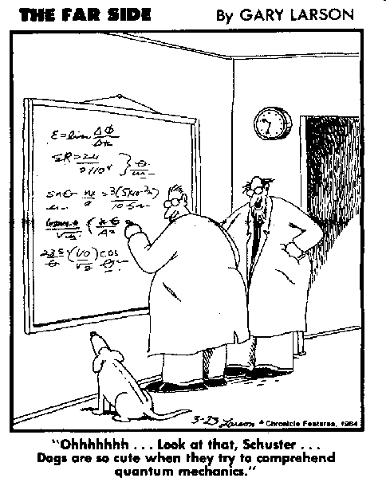
Final Exam Review

Slide 2
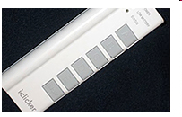
Please Return Loan Clickers to the MEG office after Class!
Today!

Slide 3

Final Exam
Wed. Wed. May 14 8 – 10 a.m.

Slide 4
Review
Always work from first Principles!

Slide 5
Review
Always work from first Principles!
Kinetics:
Free-Body Analysis
Newton’s Law
Constraints

Slide 6
Review
1. Free-Body

Slide 7
B_x
mg
B_y
1. Free-Body

Slide 8
B_x
mg
B_y
2. Newton
Moments about B: -mg*L/2 = IB*α with IB = m*L¹/₃

Slide 9
B_x
mg
B_y
3. Constraint
aG = α*L/2 = -3g/(2L) * L/2 = -3g/4

Slide 10
mg
A_x
A_y
N
1. Free-Body

Slide 11
mg
2. Newton
A_x
A_y
N
Moments about Center of Cylinder:A_x
From triangle at left:
Ax*(R-h) –b*mg = 0
acart*(R-h) –b*g = 0

Slide 12
mg
2. Newton
A_x
A_y
N
N = 0 at impending rolling, thus Ay = mg Ax = m*acart

Slide 13
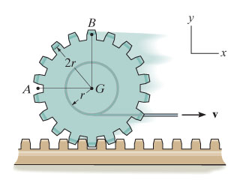
Kinematics (P. 16-126)
4r
-2r*i + 2r*j
CTR

Slide 14
Point Mass Dynamics
X-Y Coordinates

Slide 15
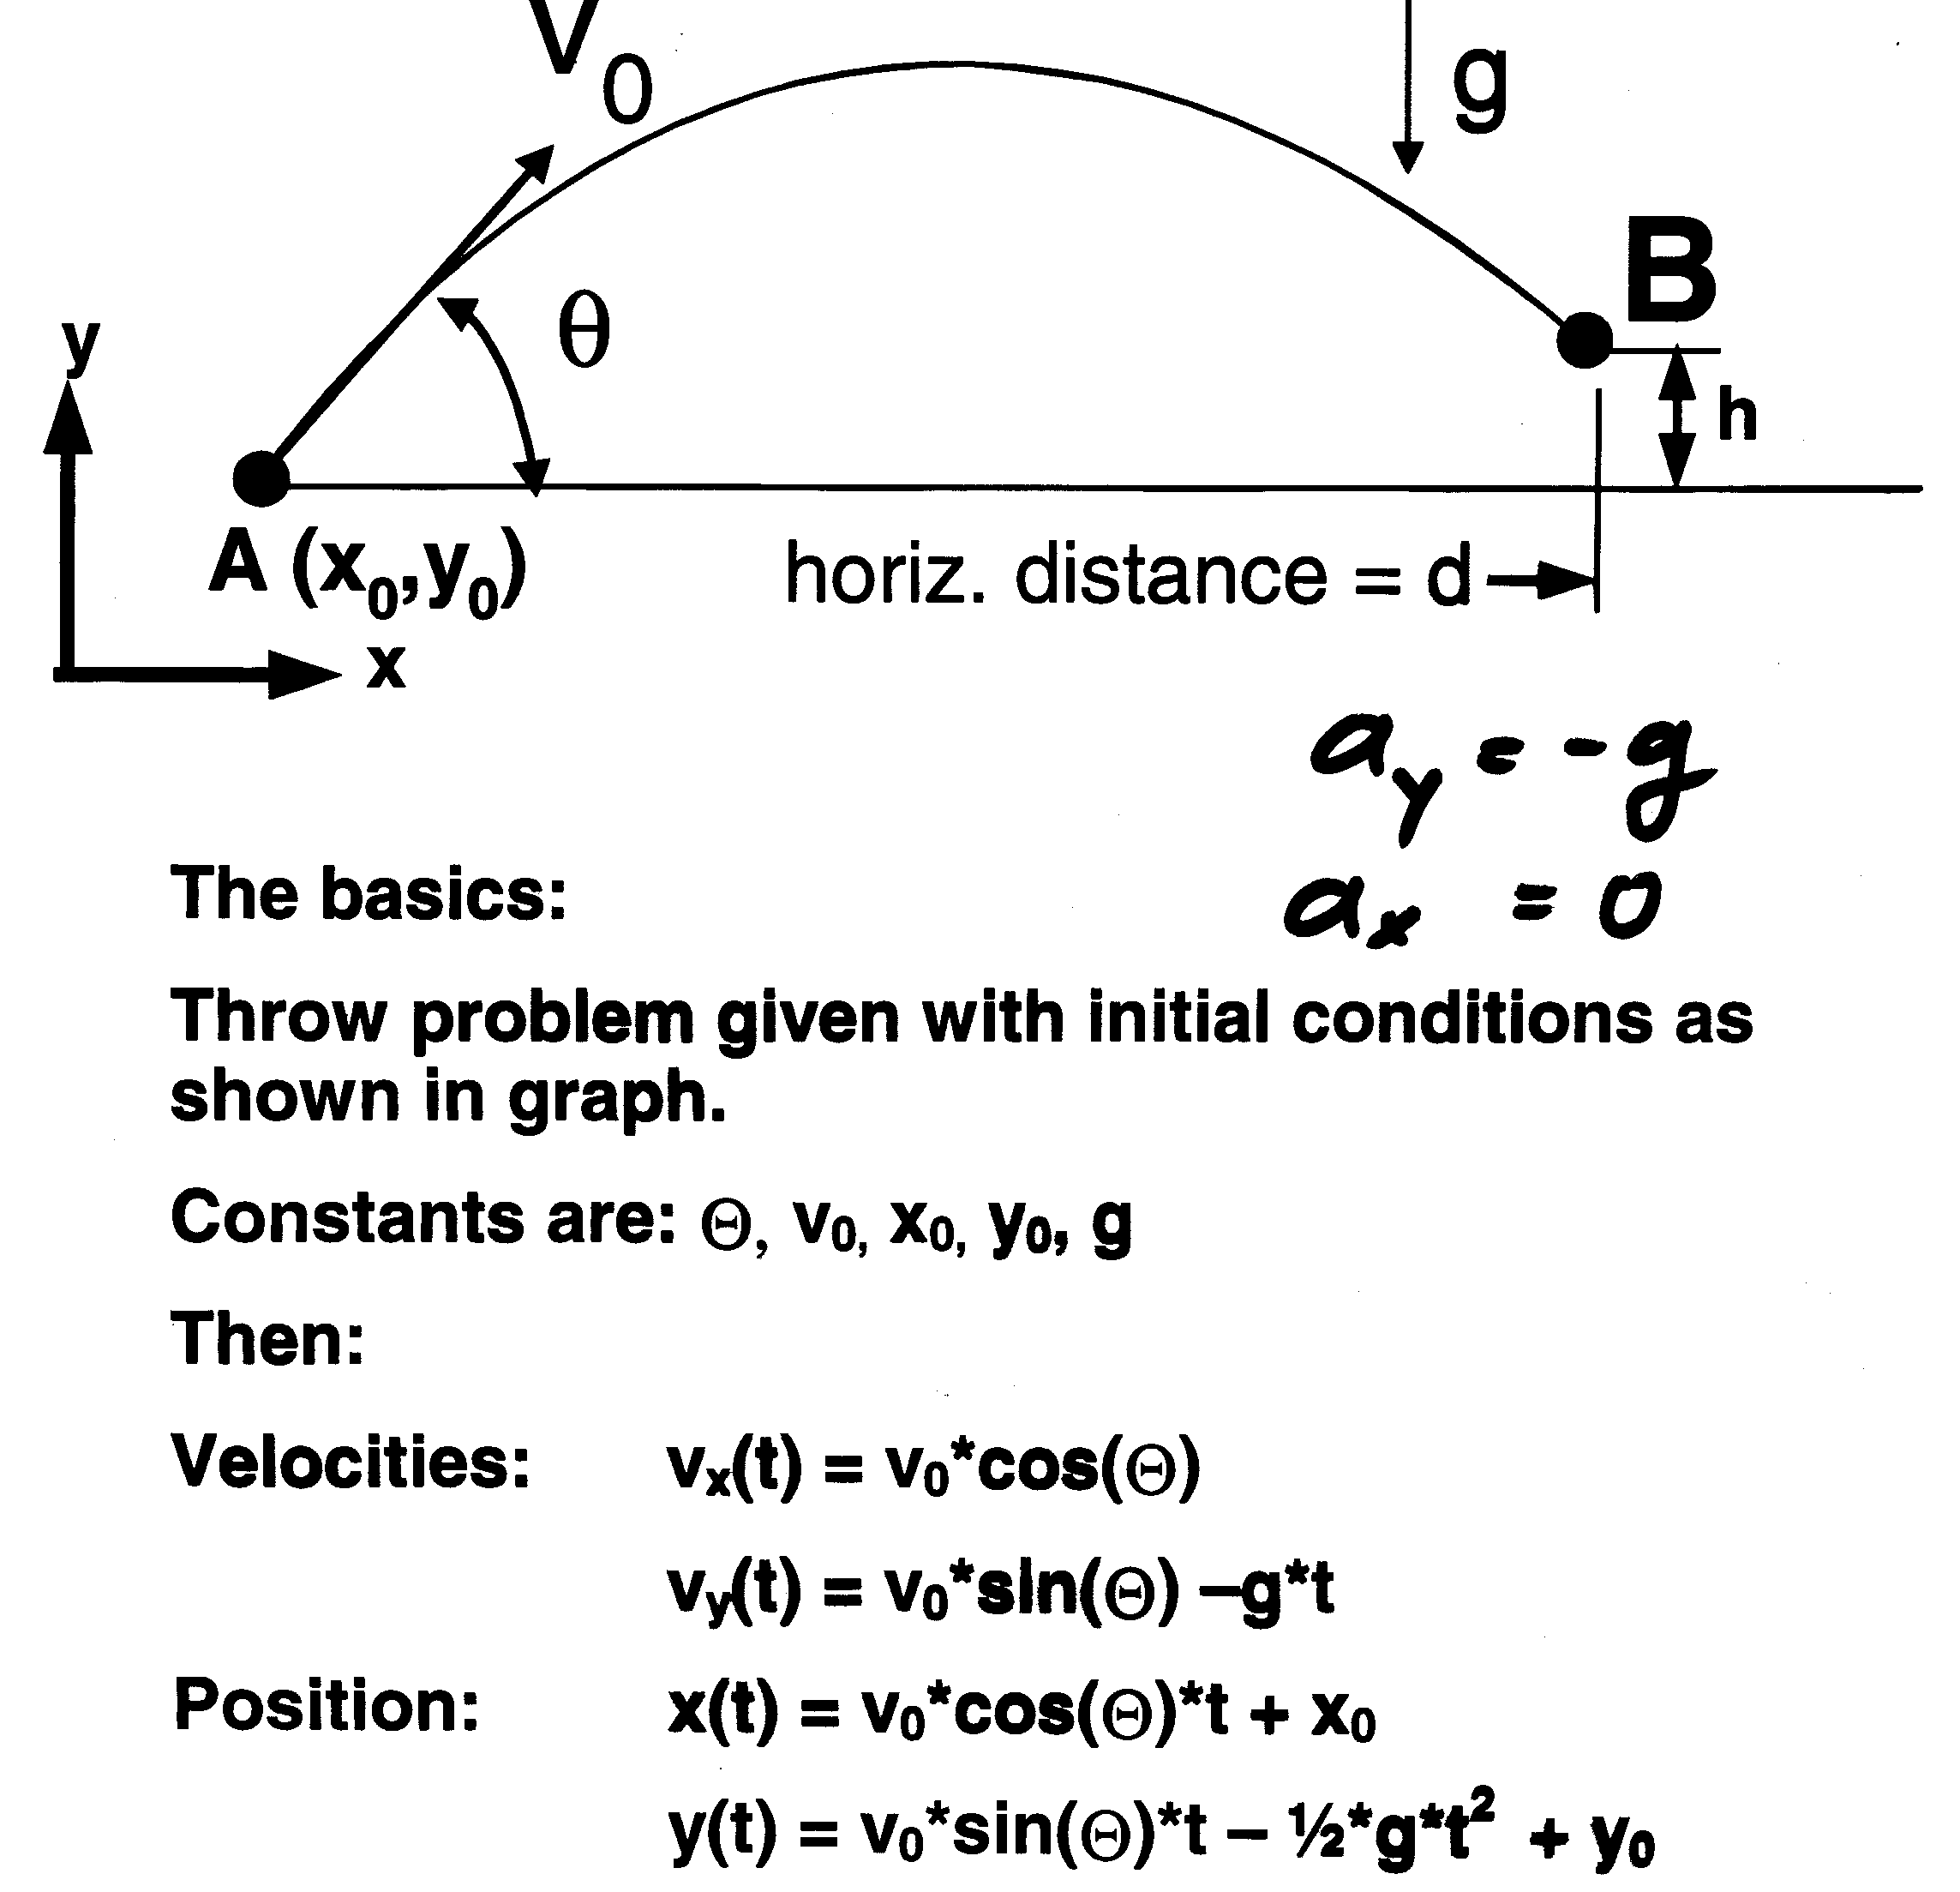

Slide 16
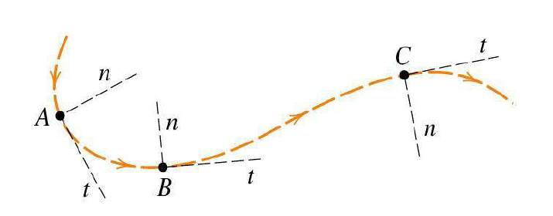
Normal and Tangential Coordinates
Velocity
Page 53

Slide 17
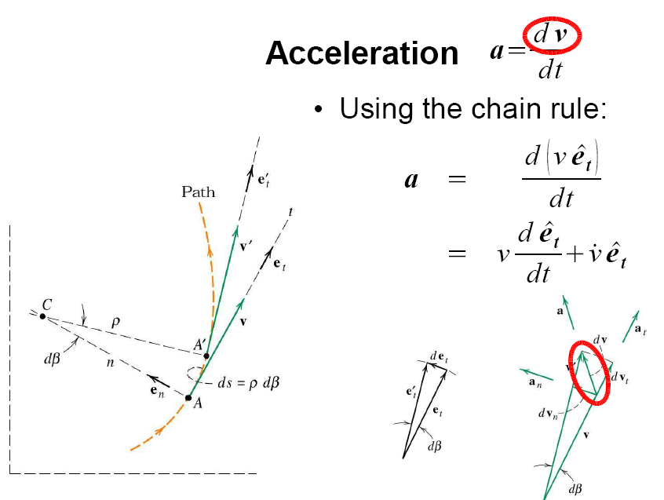
Normal and Tangential Coordinates

Slide 18
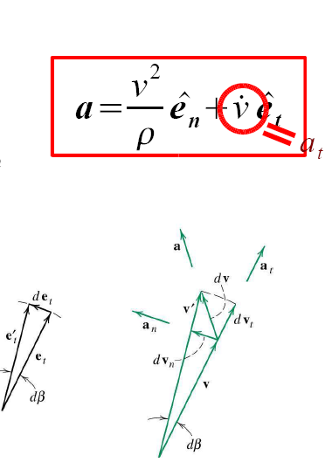

Slide 19
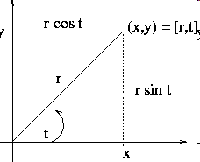
Polar coordinates

Slide 20
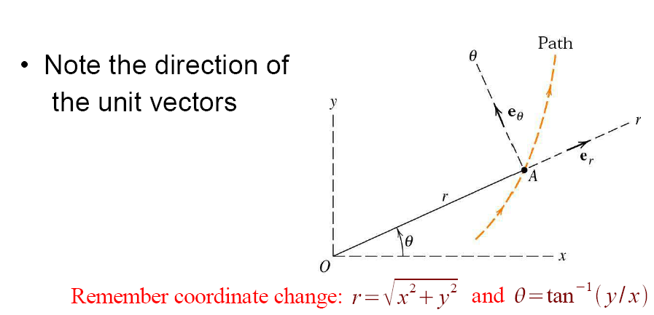
Polar coordinates

Slide 21
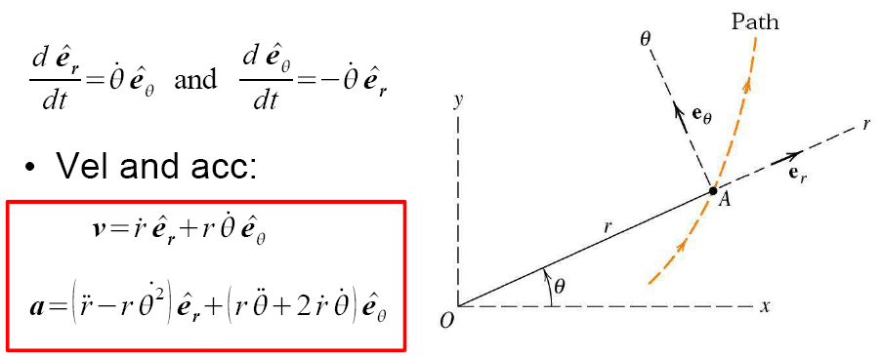
Polar coordinates

Slide 22
12.10 Relative (Constrained) Motion
We Solve Graphically (Vector Addition)
v_{A}
v_{B}
v_{B/A}

Slide 23
Example : Sailboat tacking against Northern Wind
2. Vector equation (1 scalar eqn. each in i- and j-direction)
50⁰
15⁰
i

Slide 24
Constrained Motion
v_{A} is given as shown.
Find v_{B}
Approach: Use rel. Velocity:
v_{B} = v_{A} +v_{B/A}
(transl. + rot.)

Slide 25
NEWTON'S LAW OF INERTIA
A body, not acted on by any force, remains in uniform motion.
NEWTON'S LAW OF MOTION
Moving an object with twice the mass will require twice the force.
Force is proportional to the mass of an object and
to the acceleration (the change in velocity).
F=ma.

Slide 26
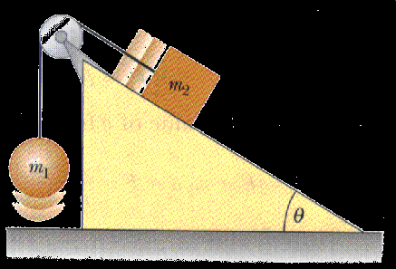
Rules
1. Free-Body Analysis, one for each mass
2. Constraint equation(s):
Define connections.
You should have as many equations as Unknowns.
COUNT!
3. Algebra:
Solve system of equations for all unknowns

Slide 27
Mass m rests on the 30 deg. Incline as shown. Step 1: Free-Body Analysis. Best approach: use coordinates tangential and normal to the path of motion as shown.
M*g*sinθ∗ι
-M*g*cosθ∗j
M*g

Slide 28
Mass m rests on the 30 deg. Incline as shown. Step 1: Free-Body Analysis.
Step 2: Apply Newton’s Law in each Direction:
M*g*sinθ∗ι
N
-M*g*cosθ∗j
M*g

Slide 29
Friction F = μ_{k}*N:
Another horizontal reaction is added in negative x-direction.
M*g*sinθ∗ι
N
μ_{k}*N
-M*g*cosθ∗j
M*g

Slide 30
Energy Methods

Slide 31
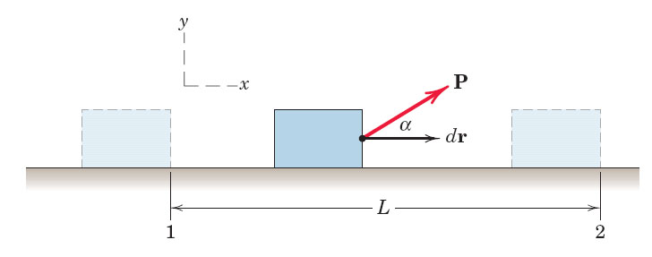
Only Force components in direction of motion do WORK

Slide 32
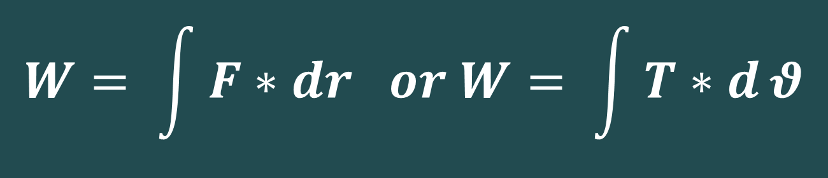
The work is defined as
$$W= \int{F∗dr or W= \int{T∗d}θ}$$
The potential energy V is defined as:

Slide 33


The work-energy relation: The relation between the work done on a particle by the forces which are applied on it and how its kinetic energy changes follows from Newton’s second law.

Slide 34
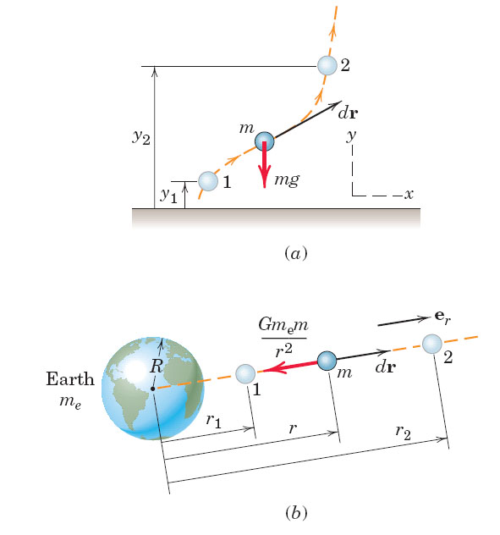
Work of Gravity

Slide 35
Conservative Forces:
  Gravity is a conservative force:
Gravity near the Earth’s surface:
A spring produces a conservative force:
Notes:
35

Slide 36
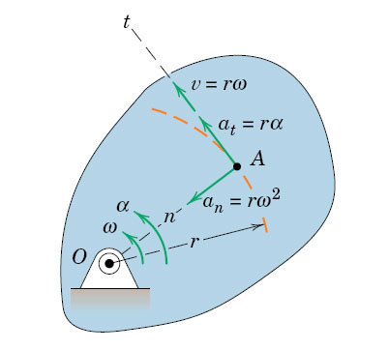
Rot. about Fixed Axis Memorize!
Notes:
36
36

Slide 37
Page 336:
a_{n} = ω x ( ω x r)
a_{t} = α x r

Slide 38
fig_05_012
Mathcad EXAMPLE

Slide 39
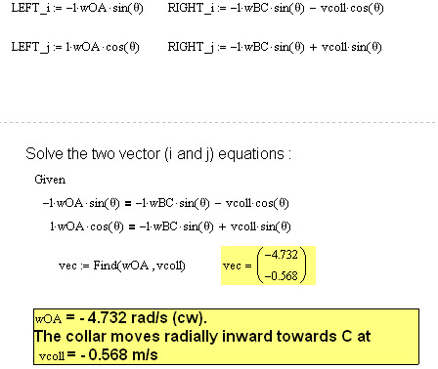
fig_05_012
Mathcad Example
part 2:
Solving the vector equations

Slide 40
fig_05_012
Mathcad Examples
part 3
Graphical Solution

Slide 43
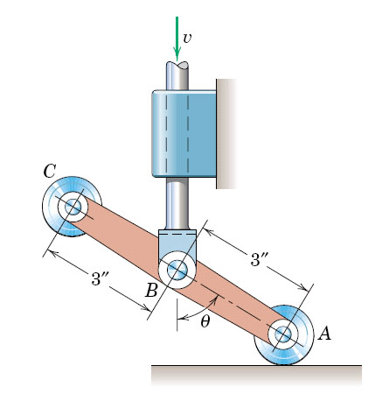
v_{B} = 3 ft/s down, Θ = 60º
and v_{A} = v_{B}/tanΘ. The relative velocity v_{A/B} is found from the vector eq.
v_{A} = v_{B}+ v_{A/B ,}v_{A/B} points
v_{A} = v_{B}+ v_{A/B ,}v_{A/B} points
(C) v_{B} = v_{A}+ v_{A/B ,}v_{A/B} points
(D) V_{B} = v_{B}+ v_{A/B ,}v_{A/B} points
y
x
v_{A}
v_{B}
v_{A}
v_{B}
v_{A/B}

Slide 44
The instantaneous center of Arm BD is located at Point:
B
D
F
G
H

Slide 45
Rigid Body Acceleration
Stresses and Flow Patterns in a Steam Turbine
FEA Visualization (U of Stuttgart)

Slide 52
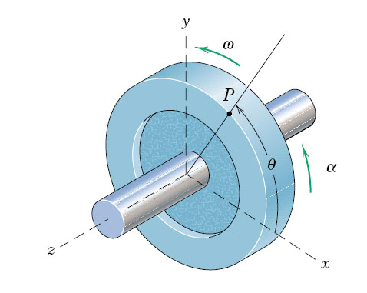
The accelerating Flywheel has R=300 mm. At θ=90º, the accel of point P is -1.8i -4.8j m/s². The velocity of point P is
0.6 m/s
1.2 m/s
2.4 m/s
12 m/s
24 m/s
At θ=90º, a_{rad} = v²/r or
v² = 4.8*0.3 thus v = 1.2

Slide 53
The accelerating Flywheel has R=300 mm. At θ=90º, the velocity of point P is 1.2 m/s. The wheel’s angular velocity ω is
8 rad/s
2 rad/s
4 rad/s
12 rad/s
36 rad/s
At θ=90º, v = 1.2 ω = v/r = 1.2/0.3 = 4 rad/s

Slide 54
Accelerating Flywheel has R=300 mm. At θ=90º, the accel is -1.8i -4.8j m/s². The magnitude of the angular acceleration α is
3 rad/s²
6 rad/s²
8 rad/s²
12 rad/s²
24 rad/s²
At θ=90º, a_{tangential} = α*R or
α = -1.8/0.3 = -6 rad/s²

Slide 55
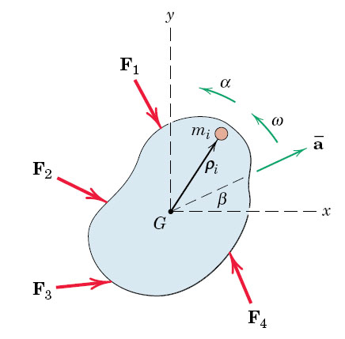
fig_06_002
Plane Motion
3 equations:
Σ Forces_x
Forces_y
Moments about G
fig_06_002

Slide 56
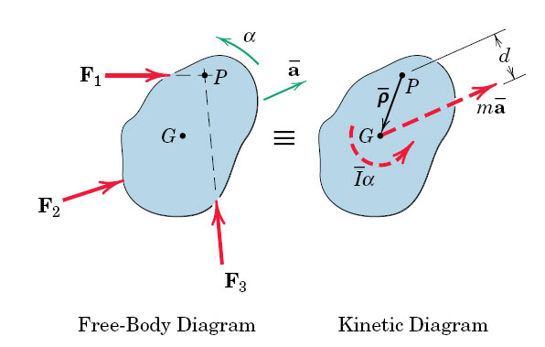
fig_06_005
Parallel Axes Theorem
Pure rotation about fixed point P
fig_06_005

Slide 57
Rigid Body Energy Methods
Chapter 18 in
Hibbeler, Dynamics
Stresses and Flow Patterns in a Steam Turbine
FEA Visualization (U of Stuttgart)

Slide 58
PROCEDURE FOR ANALYSIS
Problems involving velocity, displacement and conservative force systems can be solved using the conservation of energy equation.
• Potential energy: Draw two diagrams: one with the body located at its initial position and one at the final position. Compute the potential energy at each position using
V = V_{g} + V_{e}, where V_{g}= W y_{G} and V_{e} = 1/2 k s².
• Kinetic energy: Compute the kinetic energy of the rigid body at each location. Kinetic energy has two components: translational kinetic energy, 1/2m(v_{G})², and rotational kinetic energy,1/2 I_{G}ω².
• Apply the conservation of energy equation.

Slide 59
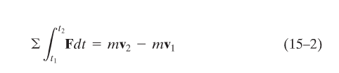
Impulse and Momentum

Slide 60
PRINCIPLE OF LINEAR IMPULSE AND MOMENTUM
(continued)
The principle of linear impulse and momentum is obtained by integrating the equation of motion with respect to time. The equation of motion can be written
∑F = m a = m (dv/dt)
Separating variables and integrating between the limits v = v₁ at t = t₁ and v = v₂ at t = t₂ results in
t₂
v₂
∑
∫
F dt
=
m
∫
dv
=
mv₂ – mv₁
t₁
v₁
This equation represents the principle of linear impulse and momentum. It relates the particle’s final velocity (v₂) and initial velocity (v₁) and the forces acting on the particle as a function of time.

Slide 61
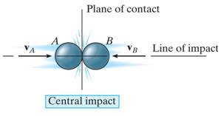
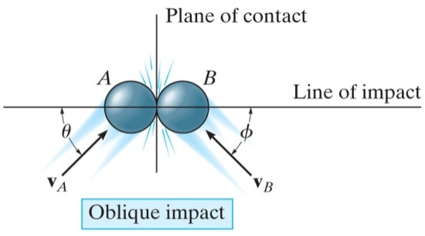
IMPACT (Section 15.4)
Impact occurs when two bodies collide during a very short time period, causing large impulsive forces to be exerted between the bodies. Common examples of impact are a hammer striking a nail or a bat striking a ball. The line of impact is a line through the mass centers of the colliding particles. In general, there are two types of impact:
Central impact occurs when the directions of motion of the two colliding particles are along the line of impact.
Oblique impact occurs when the direction of motion of one or both of the particles is at an angle to the line of impact.
Notes:
61

Slide 62
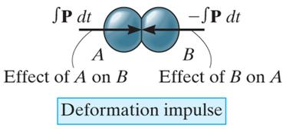
CENTRAL IMPACT
Central impact happens when the velocities of the two objects are along the line of impact (recall that the line of impact is a line through the particles’ mass centers).
v_{A}
v_{B}
Line of impact
Once the particles contact, they may deform if they are non-rigid. In any case, energy is transferred between the two particles.
There are two primary equations used when solving impact problems. The textbook provides extensive detail on their derivation.
Notes:
62

Slide 63
CENTRAL IMPACT (continued)
In most problems, the initial velocities of the particles, (v_{A})₁ and (v_{B})₁, are known, and it is necessary to determine the final velocities, (v_{A})₂ and (v_{B})₂. So the first equation used is the conservation of linear momentum, applied along the line of impact.
(m_{A} v_{A})₁ + (m_{B} v_{B})₁ = (m_{A} v_{A})₂ + (m_{B} v_{B})₂
This provides one equation, but there are usually two unknowns, (v_{A})₂ and (v_{B})₂. So another equation is needed. The principle of impulse and momentum is used to develop this equation, which involves the coefficient of restitution, or e.
Notes:
63

Slide 64
CENTRAL IMPACT (continued)
The coefficient of restitution, e, is the ratio of the particles’ relative separation velocity after impact, (v_{B})₂ – (v_{A})₂, to the particles’ relative approach velocity before impact, (v_{A})₁ – (v_{B})₁. The coefficient of restitution is also an indicator of the energy lost during the impact.
The equation defining the coefficient of restitution, e, is
(v_{B})₂ – (v_{A})₂
e =
(v_{A})₁ - (v_{B})₁
If a value for e is specified, this relation provides the second equation necessary to solve for (v_{A})₂ and (v_{B})₂.
Notes:
64

Slide 65
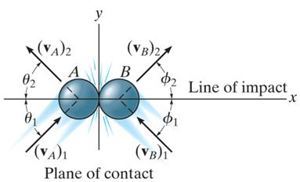
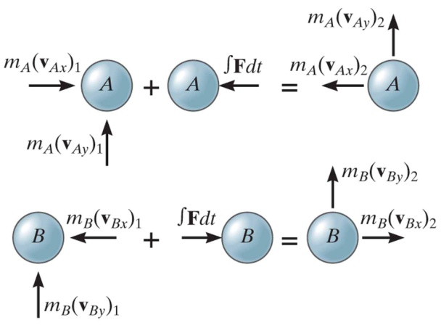
OBLIQUE IMPACT
In an oblique impact, one or both of the particles’ motion is at an angle to the line of impact. Typically, there will be four unknowns: the magnitudes and directions of the final velocities.
The four equations required to solve for the unknowns are:
Conservation of momentum and the coefficient of restitution equation are applied along the line of impact (x-axis):
m_{A}(v_{Ax})₁ + m_{B}(v_{Bx})₁ = m_{A}(v_{Ax})₂ + m_{B}(v_{Bx})₂
e = [(v_{Bx})₂ – (v_{Ax})₂]/[(v_{Ax})₁ – (v_{Bx})₁]
Momentum of each particle is conserved in the direction perpendicular to the line of impact (y-axis):
m_{A}(v_{Ay})₁ = m_{A}(v_{Ay})₂ and m_{B}(v_{By})₁ = m_{B}(v_{By})₂
Notes:
65

Slide 66
End of Review

