Slide 1
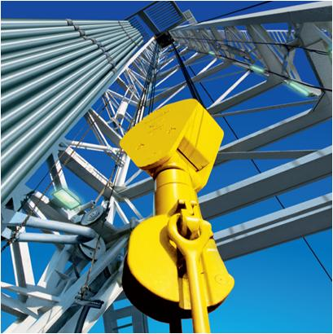
KINETIC ENERGY, WORK, PRINCIPLE OF WORK AND ENERGY
Today’s Objectives:
Students will be able to:
Define the various ways a force and couple do work.
Apply the principle of work and energy to a rigid body.

Slide 2
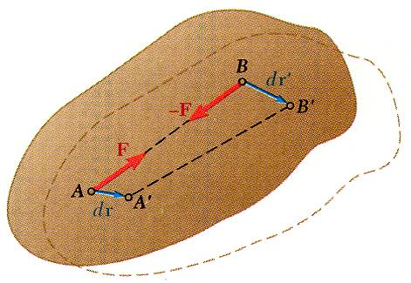
Principle of Work and Energy for a Rigid Body
Method of work and energy is well adapted to problems involving velocities and displacements. Main advantage is that the work and kinetic energy are scalar quantities.
Assume that the rigid body is made of a large number of particles.
initial and final total kinetic energy of particles forming body
total work of internal and external forces acting on particles of body.
Internal forces between particles A and B are equal and opposite.
In general, small displacements of the particles A and B are not equal but the components of the displacements along AB are equal.
Therefore, the net work of internal forces is zero.

Slide 3
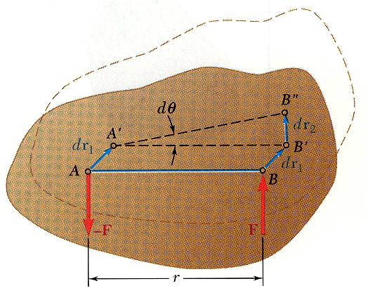
Work of Forces Acting on a Rigid Body
Work of a force during a displacement of its point of application,
Consider the net work of two forces forming a couple of moment during a displacement of their points of application.
if M is constant.

Slide 4
Work of Forces Acting on a Rigid Body
Forces acting on rigid bodies which do no work:
Forces applied to fixed points:
reactions at a frictionless pin when the supported body rotates about the pin.
Forces acting in a direction perpendicular to the displacement of their point of application:
reaction at a frictionless surface to a body moving along the surface
weight of a body when its center of gravity moves horizontally
Friction force at the point of contact of a body rolling without sliding on a fixed surface.

Slide 5
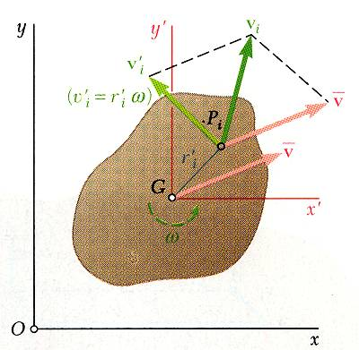
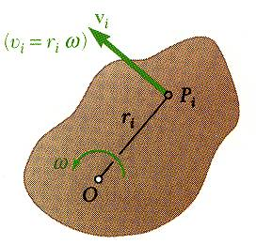
Kinetic Energy of a Rigid Body in Plane Motion
Consider a rigid body of mass m in plane motion.
Kinetic energy of a rigid body can be separated into:
the kinetic energy associated with the motion of the mass center G and
the kinetic energy associated with the rotation of the body about G.
Consider a rigid body rotating about a fixed axis through O.

Slide 6
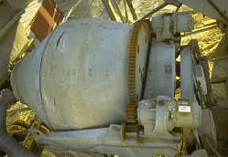
APPLICATIONS
The work of the torque (or moment) developed by the driving gears on the two motors on the concrete mixer is transformed into the rotational kinetic energy of the mixing drum.
If the motor gear characteristics are known, how would you find the rotational velocity of the mixing drum?

Slide 7
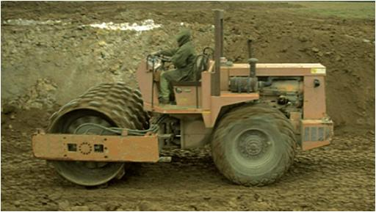
APPLICATIONS (continued)
The work done by the soil compactor's engine is transformed into the translational kinetic energy of the frame and the translational and rotational kinetic energy of the roller and wheels (excluding the internal kinetic energy developed by the moving parts of the engine and drive train).
Are the kinetic energies of the frame and the roller related to each other? If so, how?

Slide 8
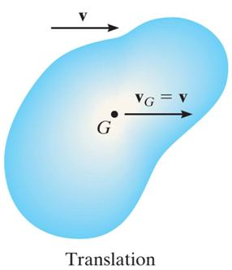
KINETIC ENERGY (Section 18.1)
The kinetic energy of a rigid body can be expressed as the sum of its translational and rotational kinetic energies. In equation form, a body in general plane motion has kinetic energy given by:
T = 1/2 m (v_{G})² + 1/2 I_{G} ω²
Several simplifications can occur.
1. Pure Translation: When a rigid body is subjected to only curvilinear or rectilinear translation, the rotational kinetic energy is zero
(ω = 0). Therefore,
T = 1/2 m (v_{G})²

Slide 9
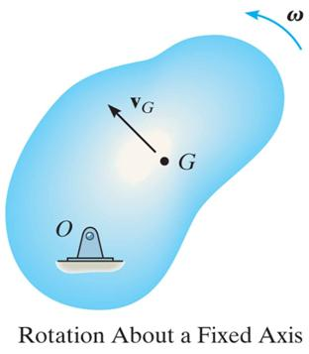
KINETIC ENERGY (continued)
2. Pure Rotation: When a rigid body is rotating about a fixed axis passing through point O, the body has both translational and rotational kinetic energy. Thus,
T = 0.5 m (v_{G})² + 0.5 I_{G} ω²
Since v_{G} = r_{G}ω, we can express the kinetic energy of the body as:
T = 0.5 [ I_{G} + m(r_{G})² ] ω² = 0.5 I_{O} ω²
If the rotation occurs about the mass center, G, then what is the value of v_{G}?
In this case, the velocity of the mass center is equal to zero. So the kinetic energy equation reduces to:
T = 0.5 I_{G} ω²

Slide 10
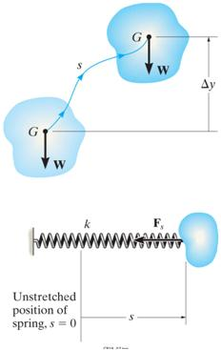
THE WORK OF A FORCE (Section 18.2)
Recall that the work done by a force can be written as:
U_{F} = ∫ F•dr = ∫ (F cos θ ) ds.
When the force is constant, this equation reduces to
U_{Fc} = (F_{c} cos θ )s where F_{c}cosθ represents the component of the force acting in the direction of the displacement, s.
s
Work of a weight: As before, the work can be expressed as U_{w} = -WΔy. Remember, if the force and movement are in the same direction, the work is positive.
Work of a spring force: For a linear spring, the work is:
U_{s} = -0.5k[(s₂)² – (s₁)²]

Slide 11
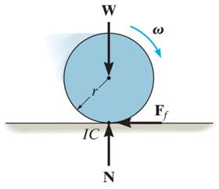
FORCES THAT DO NO WORK
There are some external forces that do no work.
For instance, reactions at fixed supports do no work because the displacement at their point of application is zero.
Normal forces and friction forces acting on bodies as they roll without slipping over a rough surface also do no work since there is no instantaneous displacement of the point in contact with ground (it is an instant center, IC).
Internal forces do no work because they always act in equal and opposite pairs. Thus, the sum of their work is zero.

Slide 12
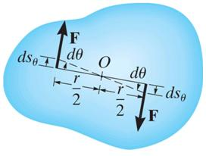
THE WORK OF A COUPLE (Section 18.3)
When a body subjected to a couple experiences general plane motion, the two couple forces do work only when the body undergoes rotation.
If the body rotates through an angular displacement dθ, the work of the couple moment, M, is:
θ₂
U_{M}
=
∫
M dθ
θ₁
If the couple moment, M, is constant, then
U_{M} = M (θ₂ – θ₁)
Here the work is positive, provided M and (θ₂ – θ₁) are in the same direction.

Slide 13
PRINCIPLE OF WORK AND ENERGY (Section 18.4)
Recall the statement of the principle of work and energy used earlier:
T₁ + ΣU₁₋₂ = T₂
In the case of general plane motion, this equation states that the sum of the initial kinetic energy (both translational and rotational) and the work done by all external forces and couple moments equals the body’s final kinetic energy (translational and rotational).
This equation is a scalar equation. It can be applied to a system of rigid bodies by summing contributions from all bodies.

Slide 14
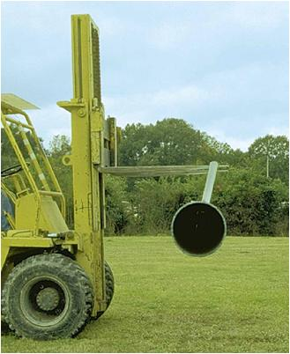
PLANAR KINETICS OF A RIGID BODY: CONSERVATION OF ENERGY
Today’s Objectives:
Determine the potential energy of conservative forces.
Apply the principle of conservation of energy.

Slide 15
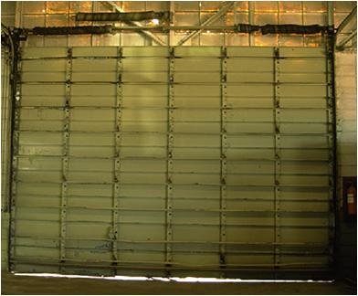
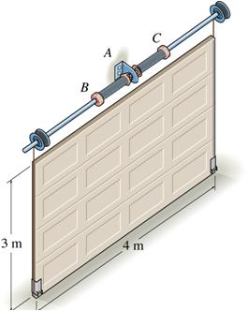
APPLICATIONS
The torsion springs located at the top of the garage door wind up as the door is lowered.
When the door is raised, the potential energy stored in the spring is transferred into the gravitational potential energy of the door’s weight, thereby making it easy to open.
Are parameters such as the torsional spring stiffness and initial rotation angle of the spring important when you install a new door?

Slide 16
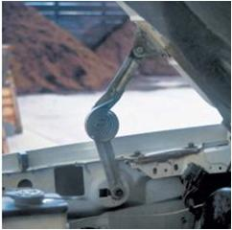
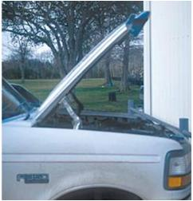
APPLICATIONS (continued)
Two torsional springs are used to assist in opening and closing the hood of the truck.
Assuming the springs are uncoiled when the hood is opened, can we determine the stiffness of each spring so that the hood can easily be lifted, i.e., practically no external force applied to it, when a person is opening it?
Are the gravitational potential energy of the hood and the torsional spring stiffness related to each other? If so, how?
Notes:
16

Slide 17
CONSERVATION OF ENERGY (Section 18.5)
The conservation of energy theorem is a “simpler” energy method (recall that the principle of work and energy is also an energy method) for solving problems.
Once again, the problem parameter of distance is a key indicator for when conservation of energy is a good method to solve a problem.
If it is appropriate for the problem, conservation of energy is easier to use than the principle of work and energy.
This is because the calculation of the work of a conservative force is simpler. But, what makes a force conservative?

Slide 18
The work is defined as
$$W= \int{F∗dr or W= \int{T∗d}θ}$$
The potential energy V is defined as:

Slide 19
Conservative Forces & Potential Energies
Force
F
Work
W(1 to 2)
Change in P.E
ΔU = U₂ - U₁
P.E. function
V
-mg(y₂-y₁)
mg(y₂-y₁)
mgy + C
(R is the center-to-center distance, x is the spring stretch)
Notes:
19

Slide 20
CONSERVATIVE FORCES
A force F is conservative if the work done by the force is independent of the path.
In this case, the work depends only on the initial and final positions of the object with the path between the positions of no consequence.
Typical conservative forces encountered in dynamics are gravitational forces (i.e., weight) and elastic forces (i.e., springs).
What is a common force that is not conservative?
Notes:
20
Friction forces!!!

Slide 21
CONSERVATION OF ENERGY
When a rigid body is acted upon by a system of conservative forces, the work done by these forces is conserved. Thus, the sum of kinetic energy and potential energy remains constant. This principle is called conservation of energy and is expressed as:
T₁ + V₁ = T₂ + V₂ = Constant
In other words, as a rigid body moves from one position to another when acted upon by only conservative forces, kinetic energy is converted to potential energy and vice versa.

Slide 22
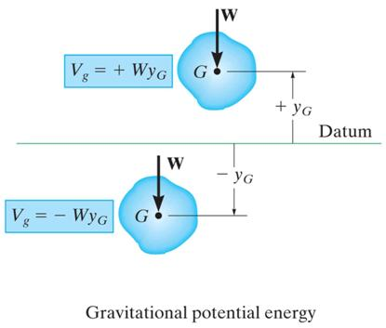
GRAVITATIONAL POTENTIAL ENERGY
The gravitational potential energy of an object is a function of the height of the body’s center of gravity above or below a datum.
The gravitational potential energy of a body is found by the equation
V_{g} = W y_{G}
Gravitational potential energy is positive when y_{G} is positive, since the weight has the ability to do positive work (why is it positive?) when the body is moved back to the datum.
Notes:
Since the movement (distance) and the force (the weight) act in the same direction.
22

Slide 23
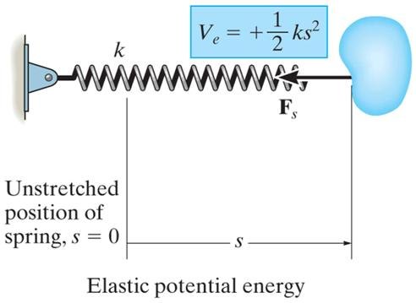
ELASTIC POTENTIAL ENERGY
Spring forces are also conservative forces.
The potential energy of a spring force (F = ks) is found by the equation
V_{e} = ½ k s²
Notice that the elastic potential energy is always positive.

Slide 24
PROCEDURE FOR ANALYSIS
Problems involving velocity, displacement and conservative force systems can be solved using the conservation of energy equation.
• Potential energy: Draw two diagrams: one with the body located at its initial position and one at the final position. Compute the potential energy at each position using
V = V_{g} + V_{e}, where V_{g}= W y_{G} and V_{e} = 1/2 k s².
• Kinetic energy: Compute the kinetic energy of the rigid body at each location. Kinetic energy has two components: translational kinetic energy, 1/2m(v_{G})², and rotational kinetic energy,1/2 I_{G}ω².
• Apply the conservation of energy equation.

Slide 25
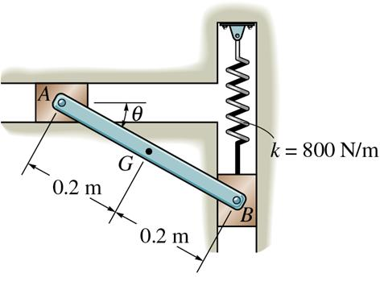
EXAMPLE I
Given: The rod AB has a mass of 10 kg. Piston B is attached to a spring of constant k = 800 N/m. The spring is un-stretched when θ = 0°. Neglect the mass of the pistons.
Find: The angular velocity of rod AB at θ = 0° if the rod is released from rest when θ = 30°.
Plan:
Use the energy conservation equation since all forces are conservative and distance is a parameter (represented here by θ). The potential energy and kinetic energy of the rod at states 1 and 2 will have to be determined.

Slide 26
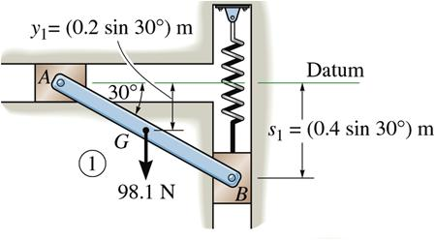
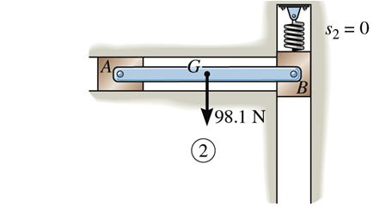
EXAMPLE I (continued)
Solution:
Initial Position Final Position
Potential Energy:
Let’s put the datum in line with the rod when θ = 0°.
Then, the gravitational potential energy and the elastic potential energy will be zero at position 2. ⇒ V₂ = 0
Gravitational potential energy at 1: - (10)( 9.81) ½ (0.4 sin 30°)
Elastic potential energy at 1: ½ (800) (0.4 sin 30°)²
So V₁ = - 9.81 + 16.0 = 6.19 N⋅m
Notes:
26

Slide 27
EXAMPLE I (continued)
Initial Position Final Position
Kinetic Energy:
The rod is released from rest from position 1.
Therefore, T₁ = 0.
At position 2, the angular velocity is ω₂ and the velocity at the center of mass is v_{G2} .
Therefore, T₂ = ½ (10)(v_{G2})² + ½ (1/12)(10)(0.4²)(ω₂)²
Notes:
27

Slide 28
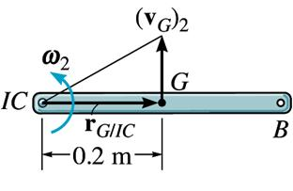
EXAMPLE I (continued)
At position 2, point A is the instantaneous center of rotation.
Hence, v_{G2} = r_{G/IC} ω = 0.2 ω₂ . Then,
T₂ = 0.2 ω₂² + 0.067 ω₂² = 0.267 ω₂²
Now apply the conservation of energy equation and solve for the unknown angular velocity, ω₂.
T₁ + V₁ = T₂ + V₂
0 + 6.19 = 0.267ω₂² + 0 ⇒ ω₂ = 4.82 rad/s

Slide 29
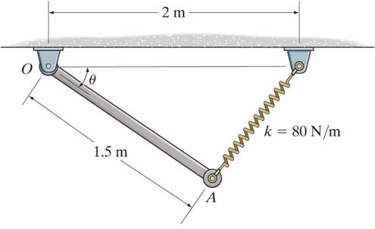
EXAMPLE II
Given: The 30 kg rod is released from rest when θ = 0°. The spring is unstretched when θ = 0°.
Find: The angular velocity of the rod when θ = 30°.
Plan:
Since distance is a parameter and all forces doing work are conservative, use conservation of energy. Determine the potential energy and kinetic energy of the system at both positions and apply the conservation of energy equation.

Slide 30
EXAMPLE II (continued)
Solution:
Potential Energy:
Let’s put the datum in line with the rod when θ = 0°.
Then, the gravitational potential energy when θ = 30° is
Datum
V_{g2} = -30 (9.81) (½ 1.5 sin 30°) = -110.4 N⋅m
The elastic potential energy at θ = 0° is zero since the spring is un-stretched. The un-stretched length of the spring is 0.5 m.
The elastic potential energy at θ = 30° is
V_{e2} = ½ 80 (√0.5²+(1.5 sin 30°) ² – 0.5)² = 6.444 N⋅m

Slide 31
EXAMPLE II (continued)
Kinetic Energy:
The rod is released from rest at θ = 0°, so v_{G1} = 0 and ω₁ = 0. Thus, the kinetic energy at position 1 is T₁ = 0.
At θ = 30°, the angular velocity is ω₂ and the velocity at the center of mass is v_{G2} .
Datum
T₂ = ½ m (v_{G2})² + ½ I_{G} (ω₂)²
= ½ (30) (v_{G2})² + ½ {(1/12) 30 (1.5)²} (ω₂)²
Since v_{G2} = (0.75 ω₂),
T₂ = ½(30) (0.75 ω₂)² + ½{(1/12)30(1.5)²} (ω₂) ²
T₂ = 11.25 (ω₂)²

Slide 32
EXAMPLE II (continued)
Now all terms in the conservation of energy equation have been formulated. Writing the general equation and then substituting into it yields:
T₁ + V₁ = T₂ + V₂
0 + 0 = 11.25 (ω₂)² + (-110.4 + 6.444)
Solving , ω₂ = 3.04 rad/s

Slide 33
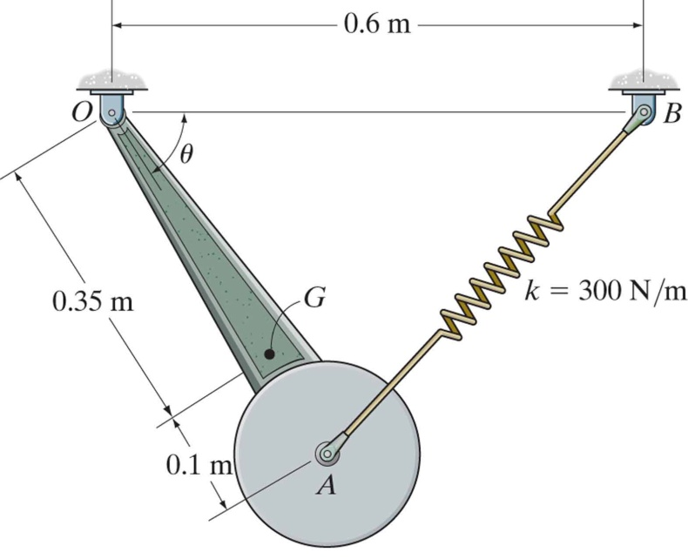
GROUP PROBLEM SOLVING
Given: The 30 kg pendulum has its mass center at G and a radius of gyration about point G of k_{G}=0.3 m.
It is released from rest when θ = 0°. The spring is unstretched when θ = 0°.
Find: The angular velocity of the pendulum when θ = 90°.
Plan:
Conservative forces and distance (θ) leads to the use of conservation of energy. First, determine the potential energy and kinetic energy for both positions. Then apply the conservation of energy equation.

Slide 34
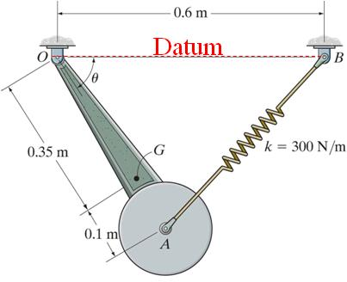
GROUP PROBLEM SOLVING (continued)
Solution:
Potential Energy:
Let’s put the datum when θ = 0°. There the gravitational potential energy is zero and the elastic potential energy will be zero. So,
V_{g1} = V_{e1} = 0
Note that the unstretched length of the spring is 0.15 m.
Gravitational potential energy at θ = 90°:
V_{g2} = - 30 (9.81) (0.35) = -103.0 N⋅m
Elastic potential energy at θ = 90° is :
V_{e2} = ½ 300 (√ 0.6² + 0.45² – 0.15)² = 54.0 N⋅m
Notes:
34

Slide 35
GROUP PROBLEM SOLVING (continued)
Kinetic Energy:
When θ = 0°, the pendulum is released from rest.
Thus, T₁ = 0.
When θ = 90°, the pendulum has a rotational motion about point O.
T₂ = ½ I_{O} (ω₂)²
where I_{O} = I_{G} + m (d_{OG})² = (30) 0.3² + 30 (0.35)² = 6.375 kg⋅m²
T₂ = ½ 6.375 (ω₂)²

Slide 36
GROUP PROBLEM SOLVING (continued)
Now, substitute into the conservation of energy equation.
T₁ + V₁ = T₂ + V₂
0 + 0 = = ½ 6.375 (ω₂)² + (-103 + 54.0)
Solving for ω yields
ω = 3.92 rad/s.

Slide 37
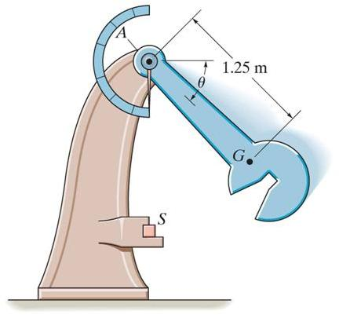
GROUP PROBLEM SOLVING
Given: The 50 kg pendulum of the Charpy impact machine is released from rest when θ = 0. The radius of gyration k_{A} = 1.75 m.
Find: The angular velocity of the pendulum when θ = 90°.
Plan:
Since the problem involves distance, the principle of work and energy is an efficient solution method. The only force involved doing work is the weight, so only its work need be determined.

Slide 38
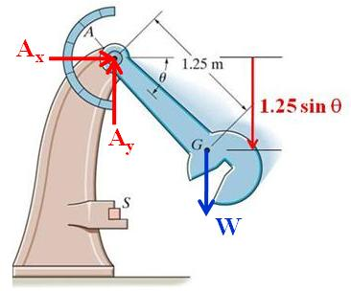
GROUP PROBLEM SOLVING (continued)
Solution:
Calculate the vertical distance the mass center moves.
Δy = 1.25 sin θ
Then, determine the work due to the weight.
U_{w} = -WΔy
U₁₋₂ = W (1.25 sin θ )
= 50(9.81) (1.25 sin 90°)
= 613.1 N·m
The mass moment of inertia about A is:
I_{A} = m (k_{A})² = 50(1.75)² = 153.1 kg·m²

Slide 39
GROUP PROBLEM SOLVING (continued)
Kinetic energy:
T₁ = 0
T₂ = 0.5m(v_{G})² + 0.5 I_{G} ω²
= 0.5 I_{A} ω²
= 0.5 (153.1) ω²
Now apply the principle of work and energy equation:
T₁ + U₁₋₂ = T₂
0 + 613.1 = 76.55 ω²
ω = 2.83 rad/s

Slide 40
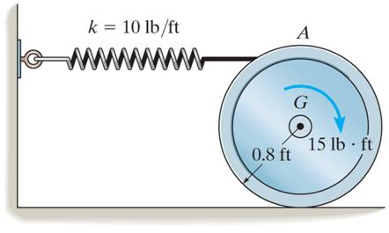
EXAMPLE
Given: The disk weighs 40 lb and has a radius of gyration (k_{G}) of 0.6 ft. A 15 ft·lb moment is applied and the spring has a spring constant of 10 lb/ft.
Find: The angular velocity of the wheel when point G moves 0.5 ft. The wheel starts from rest and rolls without slipping. The spring is initially un-stretched.
Plan:
Use the principle of work and energy to solve the problem since distance is the primary parameter. Draw a free body diagram of the disk and calculate the work of the external forces.

Slide 41
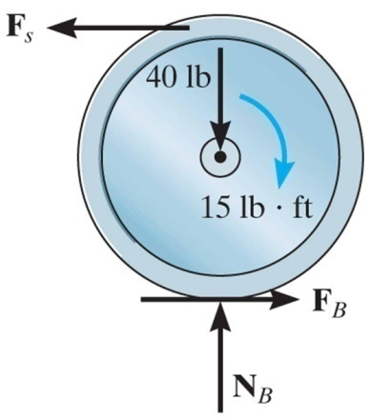
EXAMPLE (continued)
Solution:
Free body diagram of the disk:
Since the disk rolls without slipping on a horizontal surface, only the spring force and couple moment M do work. Why don’t forces F_{B} and N_{B} do any work?
Since the spring is attached to the top of the wheel, it will stretch twice the amount of displacement of G, or 1 ft.

Slide 42
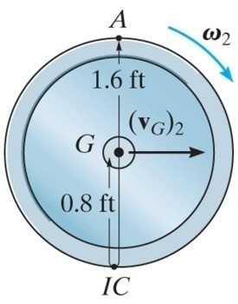
EXAMPLE (continued)
Work: U₁₋₂ = -0.5k[(s₂)² – (s₁)²] + M(θ₂ – θ₁)
U₁₋₂ = -0.5(10)(1² – 0) + 15(0.5/0.8) = 4.375 ft·lb
Kinematic relation: v_{G} = r ω = 0.8ω
Kinetic energy:
T₁ = 0
T₂ = 0.5m (v_{G})² + 0.5 I_{G} ω²
T₂ = 0.5(40/32.2)(0.8ω)² + 0.5(40/32.2)(0.6)²ω²
T₂ = 0.621 ω²
Work and energy: T₁ + U₁₋₂ = T₂
0 + 4.375 = 0.621 ω²
ω = 2.65 rad/s

