Slide 1
Principles
Learn The Method

Slide 2
Principles
Basics should be automatic
Memorize and Practice!

Slide 3
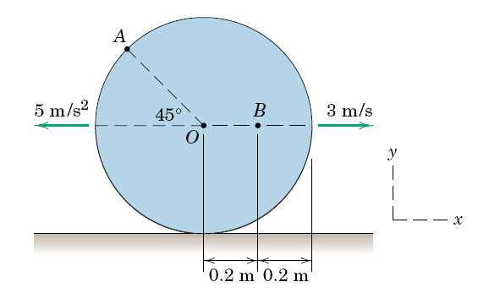
The angular velocity of the disk (r = 1m) in rad/s is
6 k
-6 k
6 i
- 3k
3 k
ω_{Disk} = v_{o} / r = -3/1 = -3 rad/s
5.129

Slide 4
The angular accel. of the disk (r = 2 m) in rad/s² is
5 k
- 5 k
- 10 k
10k
2.5 k
a_{Disk} = a_{o} / r = 5/2 = 2.5 rad/s²
5.129

Slide 5
Arm AB with Length L moves the slotted rod BD in x-direction only.
How do we determine the velocity v_{D} of point D as a function of angle θ(t)?
L
X(θ) =L*cosθ

Slide 6
Arm AB with Length L moves the slotted rod BD in x-direction only.
How do we determine the velocity v_{D} of point D as a function of angle θ(t)?
L
X(θ) =L*cosθ
X-dot(θ) =-L*sinθ∗θ_dot

Slide 7
Chapter 14
Energy Methods

Slide 8
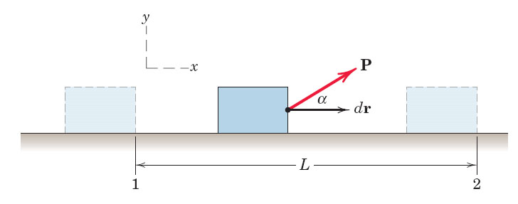
Only Force components in direction of motion do WORK

Slide 9


The work-energy relation: The relation between the work done on a particle by the forces which are applied on it and how its kinetic energy changes follows from Newton’s second law.

Slide 10
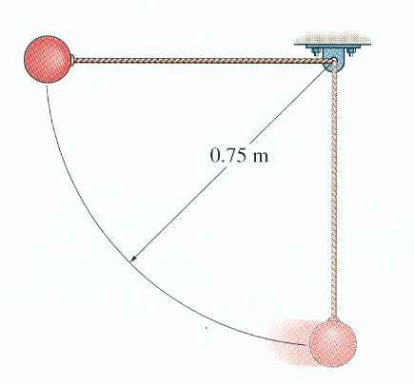
2. If the pendulum is released from the
horizontal position, the velocity of its
bob in the vertical position is _____
A) 3.8 m/s. B) 6.9 m/s.
C) 14.7 m/s. D) 21 m/s.
The work done is mgh
½*m*v² = mgh or
V = sqrt(2gh) = sqrt(14.7)
Notes:
10
Answers:
1. B
2. A

Slide 11
Power
Units of power:
J/sec = N-m/sec = Watts
1 hp = 746 W

Slide 12
The potential energy V is defined as:

Slide 13
Conservative Forces
T₁ + V₁ = T₂ + V₂

Slide 14
Potential Energy
Potential energy is energy which results from position or configuration. An object may have the capacity for doing work as a result of its position in a gravitational field. It may have elastic potential energy as a result of a stretched spring or other elastic deformation.

Slide 15
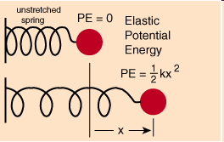

Potential Energy
elastic potential energy as a result of a stretched spring or other elastic deformation.

Slide 16
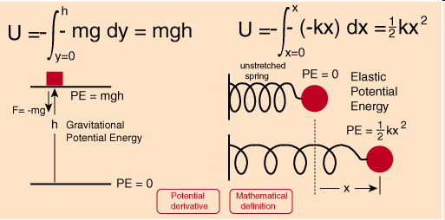
Potential Energy

Slide 17
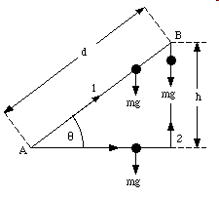

Potential Energy
y

Slide 18
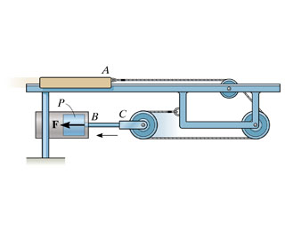

Procedure
Ex. Problem 14.26
x_{A}
1. Frame, start and end points
2. Constraint equations?
3. Apply the Energy Principle (only ext. Forces!)
2.
1.
x_{c}
$$2 xc+xA=L$$
T1 = 0, start from rest
0 + F*x_{c} = 0.5*m*(v_{A})²

Slide 19
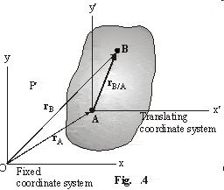
Chapter 16
Rigid Body Kinematics

Slide 20
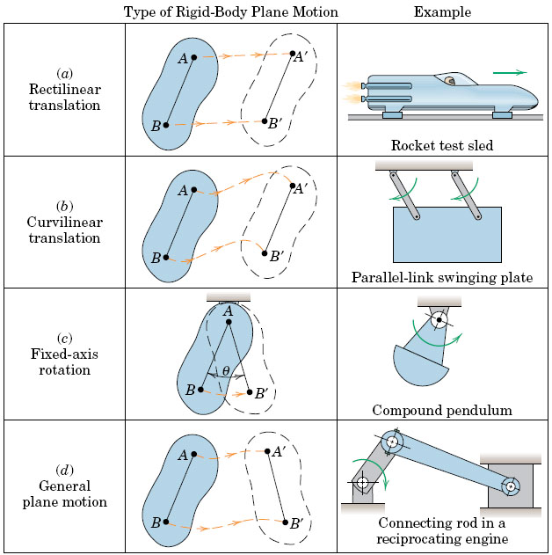
16.1
Notes:
20
20
20

Slide 21
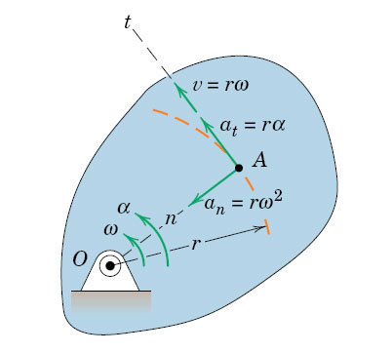
16.3 Rot. about Fixed Axis Memorize!
Notes:
21
21
21

Slide 22
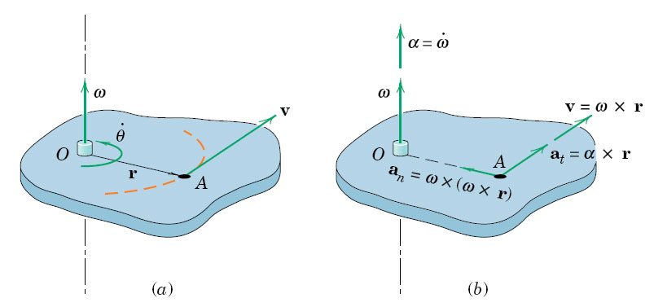
Vector Product is NOT commutative!
Notes:
22
22
22

Slide 23
Cross Product

Slide 24
Derivative of a Rotating Vector
vector r is rotating around the origin, maintaining a fixed distance
At any instant, it has an angular velocity of ω

Slide 25
Page 317:
a_{n} = ω x ( ω x r)
a_{t} = α x r

Slide 26
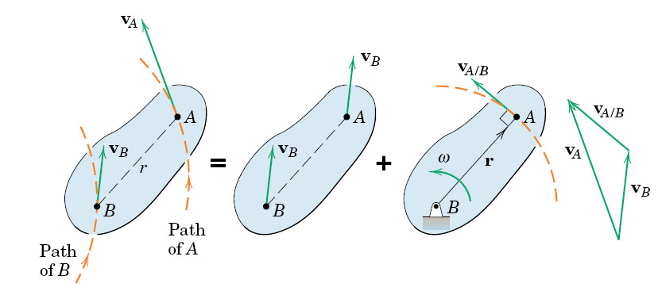
fig_05_006
General Motion = Translation + Rotation
Vector sum vA = vB + vA/B

Slide 27
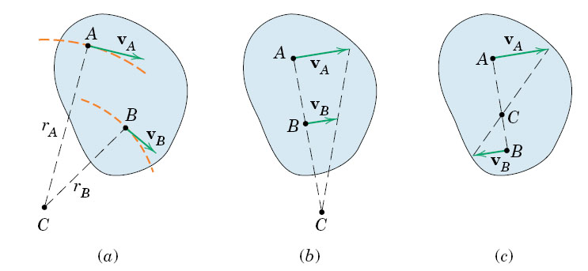
fig_05_007

Slide 28
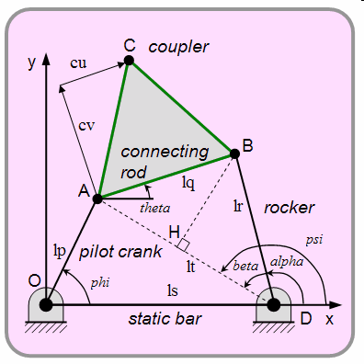
16.4 Motion Analysis

Slide 29
Approach
Geometry: Definitions
        Constants
        Variables
        Make a sketch
2a. Analysis (16.4) Derivatives (velocity and acceleration)
2b. Rel. Motion (16.5)
3. Equations of Motion
4. Solve the Set of Equations. Use Computer Tools.

Slide 30
Example
Bar BC rotates at constant ω_{BC}. Find the angular Veloc. of arm BC.
Step 1: Define the Geometry

Slide 31
Example
Bar BC rotates at constant ω_{BC}. Find the ang. Veloc. of arm BC.
Step 1: Define the Geometry

Slide 32
Geometry: Compute all lengths and angles as f(θ(t))
All angles and distance AC(t) are time-variant
Velocities: ω = γ-dot is given.

Slide 33
Rigid Body Acceleration
Chapter 16.7
Stresses and Flow Patterns in a Steam Turbine
FEA Visualization (U of Stuttgart)

Slide 34
General Procedure
Compute all velocities and angular velocities.
Start with centripetal acceleration: It is ALWAYS oriented inward towards the center.

Slide 35
General procedure
Compute all velocities and angular velocities.
Start with centripetal acceleration: It is ALWAYS oriented inward towards the center.
3. The angular accel is NORMAL to the
Centripetal acceleration.

Slide 36
General Procedure
Compute all velocities and angular velocities.
Start with centripetal acceleration: It is ALWAYS oriented inward towards the center.
3. The angular accel is NORMAL to the
Centripetal acceleration. The direction of the angular acceleration is found from the mathematical analysis.

Slide 37
ω_{AB} = -11.55k
ω_{BC} = -5k
1. Find all v_{i} and ω_{i} (Ch. 16.5)
2. View from A: aB =
α_{AB}Xr_{B} – ω_{AB}²*r_{B}
3. View from D: a_{B} = a_{C} + α_{BC}Xr_{B/C} – ω_{BC}²*r_{B/C}

Slide 38
Centripetal Terms: We know magnitudes and directions
We now can solve two simultaneous vector equations for ω_{AB} and ω_{BC}
– ω_{BC}²*r_{B/C}
– ω_{AB}²*r_{B}
a_{D}
α_{AB}Xr_{B} – ω_{AB}²*r_{B} = a_{C} + α_{BC}Xr_{B/C} – ω_{BC}²*r_{B/C}

Slide 39
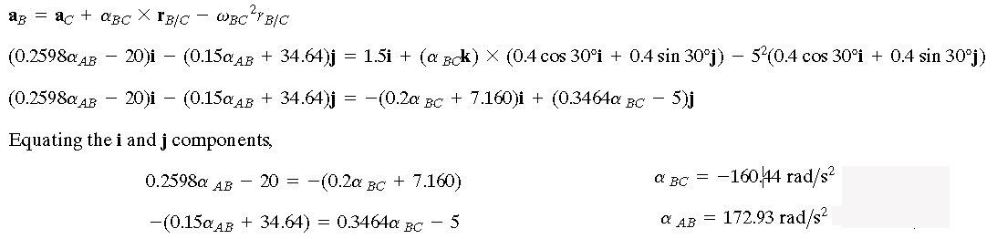
α_{AB}Xr_{B} – ω_{AB}²*r_{B} = a_{C} + α_{BC}Xr_{B/C} – ω_{BC}²*r_{B/C}

Slide 40
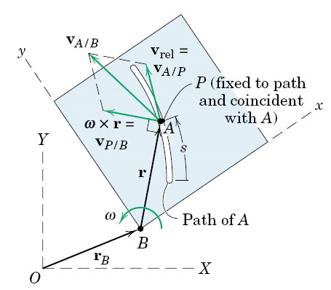
fig_05_011
16.8 Relative Motion
fig_05_11

Slide 41
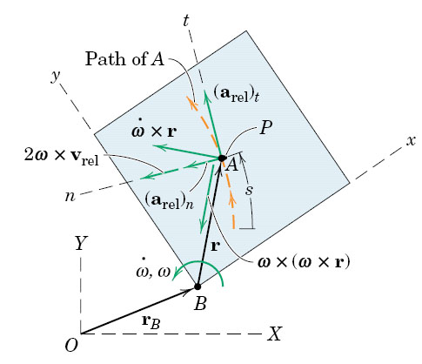
fig_05_011
16.8 Relative Motion

Slide 42

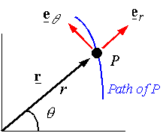
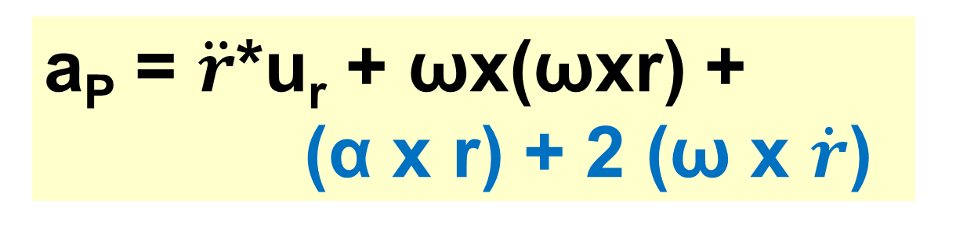
fig_05_011
16.8 Relative Motion
From Ch. 12.8
radial
a_{P} = $\ddot{r}$*u_{r} + ωx(ωxr) +
(α x r) + 2 (ω x $\dot{r}$)
tangential

Slide 43
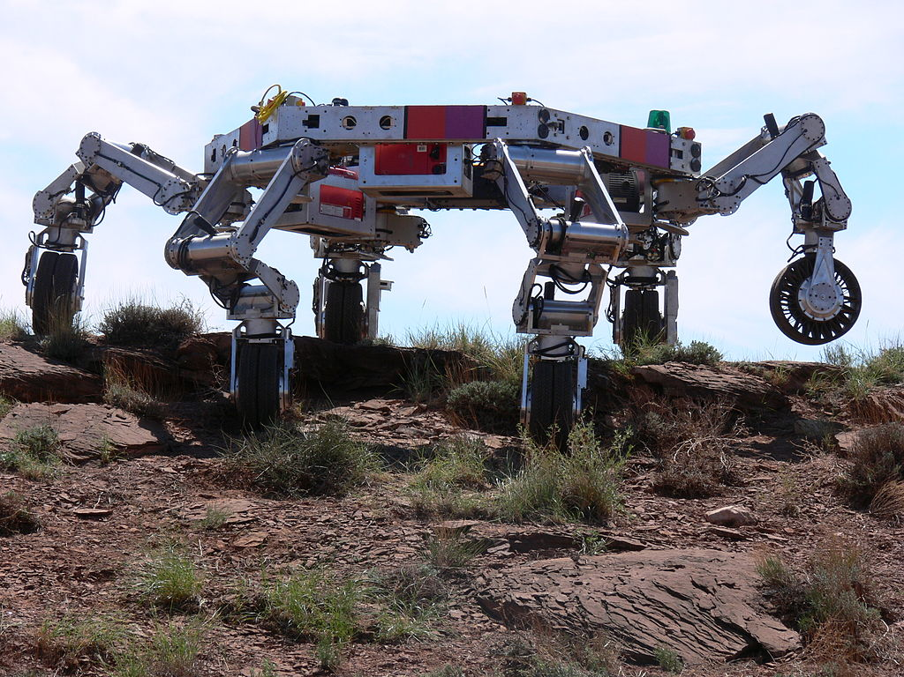
End of Review
Chapters 14 and 16

