Slide 1
Chapter 17
Rigid Body Dynamics

Slide 2
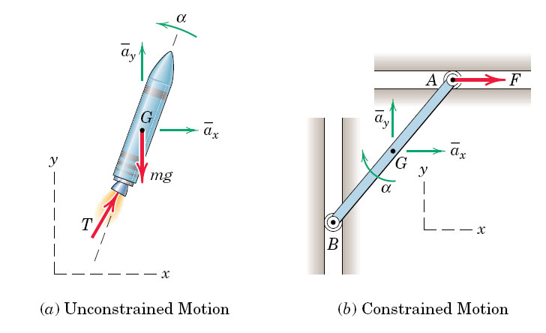
fig_06_006
Unconstrained Motion:
3 Equations for x, y, rotation

Slide 3
fig_06_006
Constrained Motion:
The system no longer has all Degrees of freedom
Describe the constraint(s) with an Equation

Slide 4
Center of Mass

Slide 5
Chapter 17 Inertial Dynamics
Frame
Free-Body
Constraint equations. You must have as many equations as unknowns. COUNT!

Slide 6
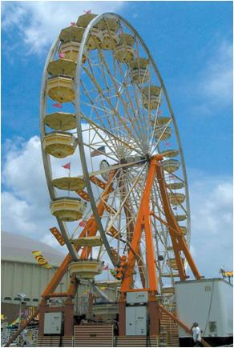
EQUATIONS OF MOTION:
ROTATION ABOUT A FIXED AXIS
Today’s Objectives:
Analyze the planar kinetics of a rigid body undergoing rotational motion.
Notes:
6

Slide 7
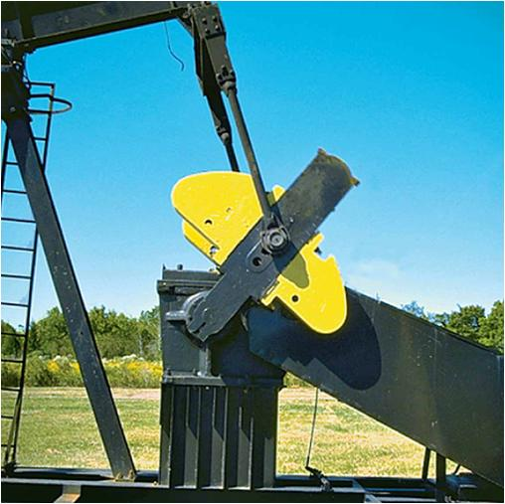
Pure Rotation
The crank on the oil-pump rig undergoes rotation about a fixed axis, caused by the driving torque, M, from a motor.
As the crank turns, a dynamic reaction is produced at the pin. This reaction is a function of angular velocity, angular acceleration, and the orientation of the crank.
Pin at the center of rotation.
If the motor exerts a constant torque M on the crank, does the crank turn at a constant angular velocity?

Slide 8
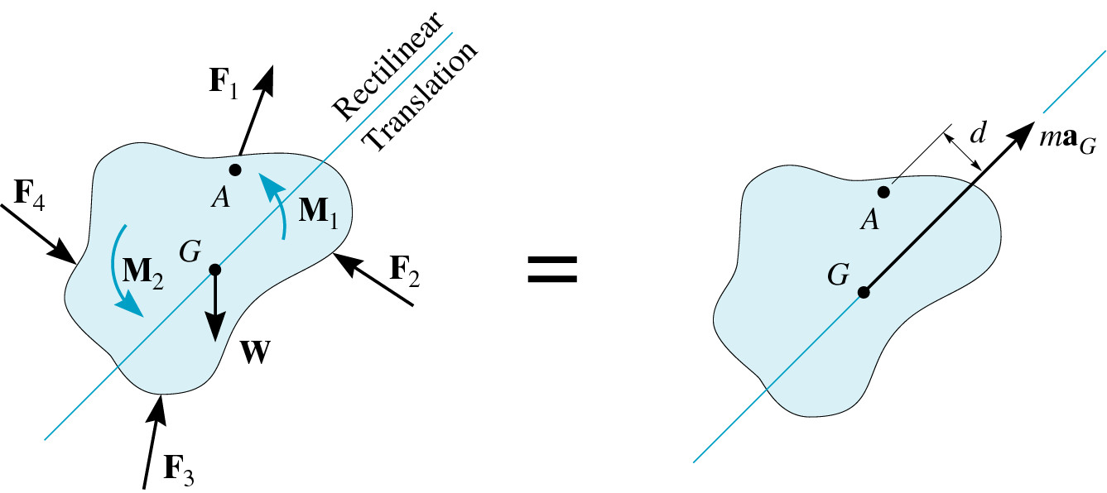
EQUATIONS OF MOTION: TRANSLATION
(Section 17.3)
When a rigid body undergoes only translation, all the particles of the body have the same acceleration so a_{G} = a and α = 0. The equations of motion become:
Σ F_{x} = m(a_{G})_{x}
Σ F_{y} = m(a_{G})_{y}
Σ M_{G} = 0
Note that, if it makes the problem easier, the moment equation can be applied about another point instead of the mass center. For example, if point A is chosen,
ΣM_{A} = (m a_{G} ) d .
Notes:
8

Slide 9
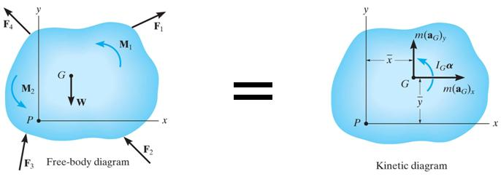
EQUATIONS OF ROTATIONAL MOTION
We need to determine the effects caused by the moments of an external force system.
The moment about point P can be written as:
Σ (r_{i} × F_{i}) + Σ M_{i} = r × ma_{G} + I_{G}α
Σ M_{p} = Σ(M_{k})_{p}
where r = x i + y j and Σ M_{p} is the resultant moment about P due to all the external forces.
The term Σ(M_{k})_{p} is called the kinetic moment about point P.
Notes:
9

Slide 10
EQUATIONS OF ROTATIONAL MOTION (continued)
If point P coincides with the mass center G, this equation reduces to the scalar equation of ΣM_{G} = I_{G} α .
In words: the resultant (summation) moment about the mass center due to all the external forces is equal to the moment of inertia about G times the angular acceleration of the body.
Thus, three independent scalar equations of motion may be used to describe the general planar motion of a rigid body. These equations are:
Σ F_{x} = m(a_{G})_{x}
Σ F_{y} = m(a_{G})_{y}
and Σ M_{G} = I_{G}α or Σ M_{p} = Σ (M_{k})_{p}
Notes:
10

Slide 11
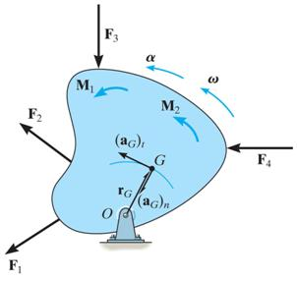
EQUATIONS OF MOTION: ROTATION ABOUT A FIXED AXIS
When a rigid body rotates about a fixed axis perpendicular to the plane of the body at point O, the body’s center of gravity G moves in a circular path of radius r_{G}. Thus, the acceleration of point G can be represented by a tangential component (a_{G})_{t} = r_{G} α and a normal component (a_{G})_{n} = r_{G} ω².
Since the body experiences an angular acceleration, its inertia creates a moment of magnitude, I_{g}α, equal to the moment of the external forces about point G. Thus, the scalar equations of motion can be stated as:
∑ F_{n} = m (a_{G})_{n} = m r_{G} ω²
∑ F_{t} = m (a_{G})_{t} = m r_{G} α
∑ M_{G} = I_{G} α

Slide 12
EQUATIONS OF MOTION (continued)
Note that the ∑M_{G} moment equation may be replaced by a moment summation about any arbitrary point. Summing the moment about the center of rotation O yields
∑M_{O} = I_{G}α + r_{G} m (a_{G}) _{t} = [I_{G} + m(r_{G})²] α
From the parallel axis theorem, I_{O} = I_{G} + m(r_{G})², therefore the term in parentheses represents I_{O}.
Consequently, we can write the three equations of motion for the body as:
∑F_{n} = m (a_{G})_{n} = m r_{G} ω²
∑F_{t} = m (a_{G})_{t} = m r_{G} α
∑M_{O} = I_{O} α

Slide 13
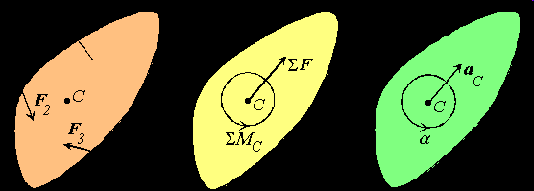

Chapter 17.5
General Plane Motion
=
=
Remember Rel. Motion Kinematics:

Slide 14
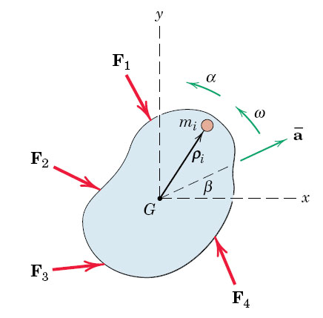
fig_06_002
Plane Motion
3 equations:
Σ Forces_x
Forces_y
Moments about G
fig_06_002

Slide 15
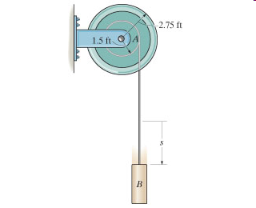
Chapter 17.5
Constraints
Constraint Equations are required whenever there are more independent variables than degrees of Freedom.
Example:
We choose two coordinates:
y downward
θ counterclockwise.
The constraint eq. is y = -R*θ

Slide 16
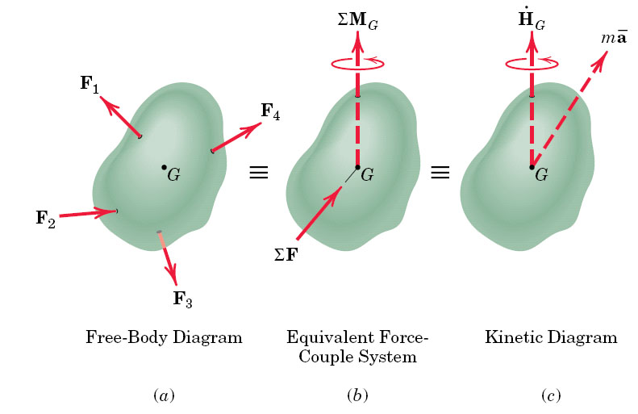
fig_06_001
fig_06_001

Slide 17
fig_06_001
fig_06_001

Slide 18
fig_06_002
Plane Motion
fig_06_002

Slide 19
fig_06_002
Plane Motion
3 equations:
Σ Forces_x
Forces_y
Moments about G
fig_06_002

Slide 20
fig_06_002
Plane Motion
3 equations:
Σ Forces_x
Forces_y
Moments about G
fig_06_002

Slide 21
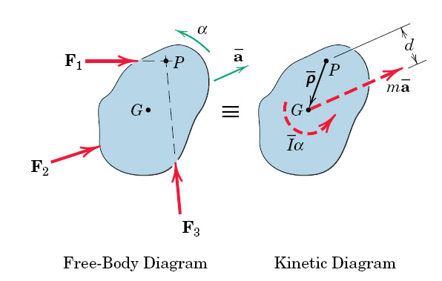
fig_06_005
Parallel Axes Theorem
fig_06_005

Slide 22
fig_06_005
Parallel Axes Theorem
Pure rotation about fixed point P
fig_06_005

Slide 23
fig_06_005
Radius of Gyration
Pure rotation about center G
Inertia is concentrated at radius k

Slide 24
fig_06_005
2 Equations:

Slide 25
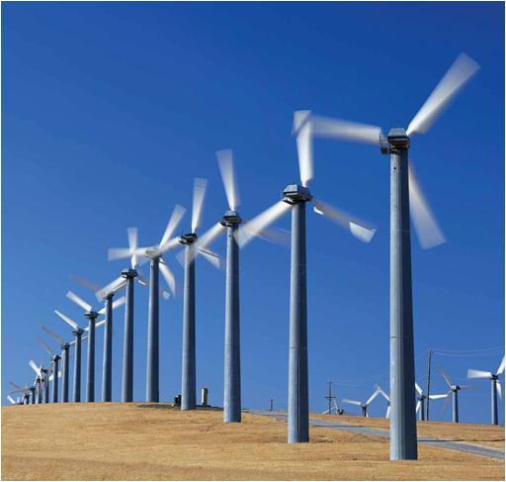
PLANAR RIGID BODY MOTION: TRANSLATION & ROTATION
Today’s Objectives :
Students will be able to:
Analyze the kinematics of a rigid body undergoing planar translation or rotation about a fixed axis.
In-Class Activities :
• Check Homework
• Reading Quiz
• Applications
• Types of Rigid-Body Motion
• Planar Translation
• Rotation About a Fixed Axis
• Concept Quiz
• Group Problem Solving
• Attention Quiz

Slide 26
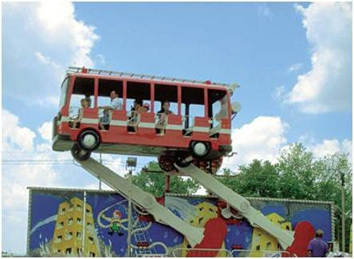
APPLICATIONS
Passengers on this amusement ride are subjected to curvilinear translation since the vehicle moves in a circular path but they always remains upright.
If the angular motion of the rotating arms is known, how can we determine the velocity and acceleration experienced by the passengers? Why would we want to know these values?
Does each passenger feel the same acceleration?

Slide 27
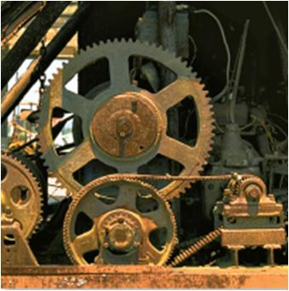
APPLICATIONS (continued)
Gears, pulleys and cams, which rotate about fixed axes, are often used in machinery to generate motion and transmit forces. The angular motion of these components must be understood to properly design the system.
To do this design, we need to relate the angular motions of contacting bodies that rotate about different fixed axes. How is this different than the analyses we did in earlier chapters?

Slide 28
RIGID BODY MOTION (Section 16.1)
There are cases where an object cannot be treated as a particle. In these cases the size or shape of the body must be considered. Rotation of the body about its center of mass requires a different approach.
For example, in the design of gears, cams, and links in machinery or mechanisms, rotation of the body is an important aspect in the analysis of motion.
We will now start to study rigid body motion. The analysis will be limited to planar motion.
A body is said to undergo planar motion when all parts of the body move along paths equidistant from a fixed plane.

Slide 29
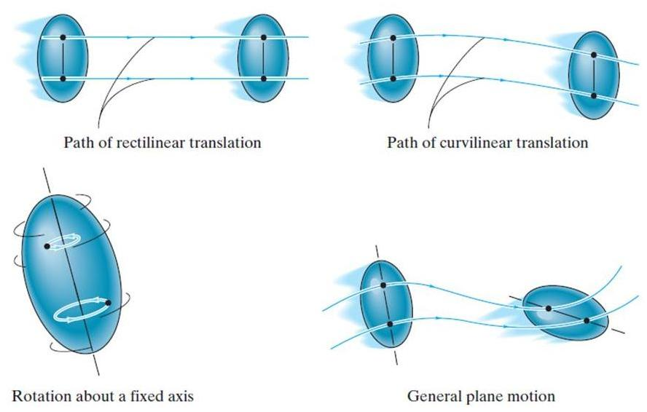
PLANAR RIGID BODY MOTION
There are three types of planar rigid body motion.

Slide 30
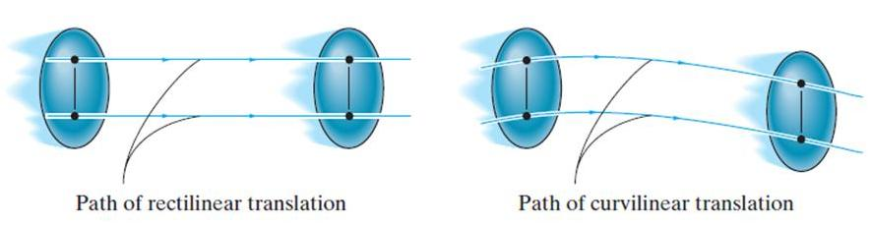
PLANAR RIGID BODY MOTION
(continued)
Translation: Translation occurs if every line segment on the body remains parallel to its original direction during the motion. When all points move along straight lines, the motion is called rectilinear translation. When the paths of motion are curved lines, the motion is called curvilinear translation.

Slide 31
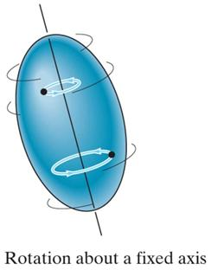
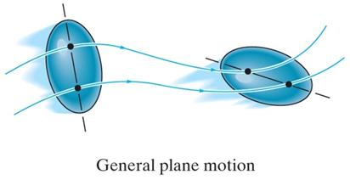
PLANAR RIGID BODY MOTION
(continued)
Rotation about a fixed axis: In this case, all the particles of the body, except those on the axis of rotation, move along circular paths in planes perpendicular to the axis of rotation.
General plane motion: In this case, the body undergoes both translation and rotation. Translation occurs within a plane and rotation occurs about an axis perpendicular to this plane.

Slide 32
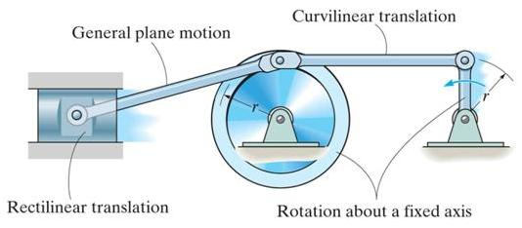
PLANAR RIGID BODY MOTION
(continued)
An example of bodies undergoing the three types of motion is shown in this mechanism.
The wheel and crank undergo rotation about a fixed axis. In this case, both axes of rotation are at the location of the pins and perpendicular to the plane of the figure.
The piston undergoes rectilinear translation since it is constrained to slide in a straight line.
The connecting rod undergoes curvilinear translation, since it will remain horizontal as it moves along a circular path.
The connecting rod undergoes general plane motion, as it will both translate and rotate.

Slide 33
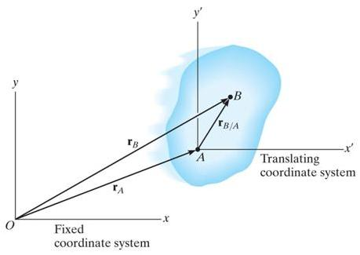
RIGID-BODY MOTION: TRANSLATION
(Section 16.2)
The positions of two points A and B on a translating body can be related by
r_{B} = r_{A} + r_{B/A}
where r_{A} & r_{B} are the absolute position vectors defined from the fixed x-y coordinate system, and r_{B/A} is the relative-position vector between B and A.
The velocity at B is v_{B} = v_{A}+ dr_{B/A}/dt .
Now dr_{B/A}/dt = 0 since r_{B/A} is constant. So, v_{B} = v_{A}, and by following similar logic, a_{B} = a_{A}.
Note, all points in a rigid body subjected to translation move with the same velocity and acceleration.

Slide 34
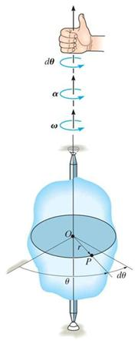
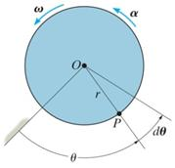
RIGID-BODY MOTION: ROTATION ABOUT A FIXED AXIS (Section 16.3)
When a body rotates about a fixed axis, any point P in the body travels along a circular path. The angular position of P is defined by θ.
The change in angular position, dθ, is called the angular displacement, with units of either radians or revolutions. They are related by
1 revolution = (2π) radians
Angular velocity, ω, is obtained by taking the time derivative of angular displacement:
ω = dθ/dt (rad/s) +
Similarly, angular acceleration is
α = d²θ/dt² = dω/dt or α = ω(dω/dθ) + rad/s²

Slide 35

RIGID-BODY MOTION: ROTATION ABOUT A FIXED AXIS (continued)
If the angular acceleration of the body is constant, α = α_{C,} the equations for angular velocity and acceleration can be integrated to yield the set of algebraic equations below.
ω = ω₀ + α_{C} t
θ = θ₀ + ω₀ t + 0.5 α_{C} t²
ω² = (ω₀)² + 2α_{C} (θ – θ₀)
θ₀ and ω₀ are the initial values of the body’s angular position and angular velocity. Note these equations are very similar to the constant acceleration relations developed for the rectilinear motion of a particle.

Slide 36
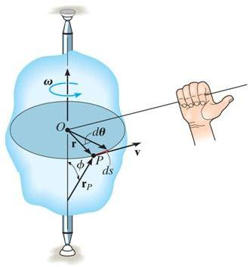
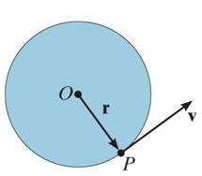
RIGID-BODY ROTATION: VELOCITY OF POINT P
The magnitude of the velocity of P is equal to ωr (the text provides the derivation). The velocity’s direction is tangent to the circular path of P.
In the vector formulation, the magnitude and direction of v can be determined from the cross product of ω and r_{p} . Here r_{p} is a vector from any point on the axis of rotation to P.
v = ω × r_{p} = ω × r
The direction of v is determined by the right-hand rule.

Slide 37
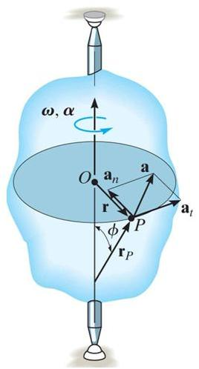
RIGID-BODY ROTATION: ACCELERATION OF POINT P
The acceleration of P is expressed in terms of its normal (a_{n}) and tangential (a_{t}) components.
In scalar form, these are a_{t} = α r and a_{n} = ω² r.
The tangential component, a_{t}, represents the time rate of change in the velocity's magnitude. It is directed tangent to the path of motion.
The normal component, a_{n}, represents the time rate of change in the velocity’s direction. It is directed toward the center of the circular path.

Slide 38
RIGID-BODY ROTATION: ACCELERATION OF POINT P (continued)
Using the vector formulation, the acceleration of P can also be defined by differentiating the velocity.
a = dv/dt = dω/dt × r_{P} + ω × dr_{P}/dt
= α × r_{P} + ω × (ω × r_{P})
It can be shown that this equation reduces to
a = α × r – ω²r = a_{t} + a_{n}
The magnitude of the acceleration vector is a = (a_{t})² + (a_{n})²

Slide 39
ROTATION ABOUT A FIXED AXIS: PROCEDURE
• Establish a sign convention along the axis of rotation.
• If a relationship is known between any two of the variables (α, ω, θ, or t), the other variables can be determined from the equations: ω = dθ/dt α = dω/dt α dθ = ω dω
• If α is constant, use the equations for constant angular acceleration.
• To determine the motion of a point, the scalar equations v = ω r, a_{t} = α r, a_{n} = ω²r , and a = (a_{t})² + (a_{n})² can be used.
• Alternatively, the vector form of the equations can be used (with i, j, k components).
v = ω × r_{P} = ω × r
a = a_{t} + a_{n} = α × r_{P} + ω × (ω × r_{P}) = α × r – ω²r

Slide 40
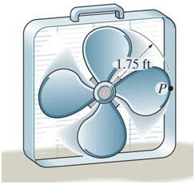
EXAMPLE
Given: The motor gives the blade an angular acceleration α = 20 e^{-0.6t} rad/s², where t is in seconds. The initial conditions are that
when t = 0, the blade is at rest.
Find: The velocity and acceleration of the tip P of one of the blades when t =3 s. How many revolutions has the blade turned in 3 s ?
Plan:
1) Determine the angular velocity and displacement of the blade using kinematics of angular motion.
2) The magnitudes of the velocity and acceleration of point P can be determined from the scalar equations of motion for a point on a rotating body. Why scalar?

Slide 41
EXAMPLE (continued)
Solution:
1) Since the angular acceleration is given as a function of time, α = 20 e^{-0.6t} rad/s² , the angular velocity and displacement can be found by integration.
= ∫ α dt = 20 ∫ e^{-0.6t} dt
ω = e^{-0.6t}
20
when t = 3 s,
ω = -5.510 rad/s
(-0.6)
Angular displacement
θ = ∫ ω dt
θ = ∫ e^{-0.6t} dt = e^{-0.6t}
20
20
when t = 3 s,
θ = 9.183 rad
= 1.46 rev.
(-0.6)
(-0.6)²
Also , when t = 3 s, α = 20 e^{-0.6(3) b}= 3.306 rad/s²

Slide 42
EXAMPLE (continued)
2) The velocity of point P on the the fan, at a radius of 1.75 ft, is determined as
v_{P} = ω r = (5.510)(1.75) = 9.64 ft/s
The normal and tangential components of acceleration of point P are calculated as
a_{n} = (ω)² r = (5.510)² (1.75) = 53.13 ft/s²
a_{t} = α r = (3.306)(1.75) = 5.786 ft/s²
The magnitude of the acceleration of P is determined by
a_{P} = (a_{n})² + (a_{t})² = (53.13)² + (5.786)² = 53.4 ft/s²

Slide 43
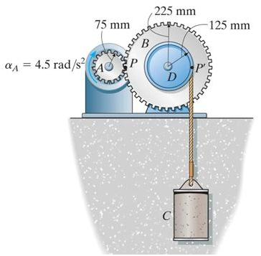
GROUP PROBLEM SOLVING
Given: Starting from rest when gear A is given a constant angular acceleration, α_{A} = 4.5 rad/s². The cord is wrapped around pulley D which is rigidly attached to gear B.
Find: The velocity of cylinder C and
the distance it travels in 3 seconds.
1) The angular acceleration of gear B (and pulley D) can be related to α_{A}.
2) The acceleration of cylinder C can be determined by using the equations for motion of a point on a rotating body since (a_{t})_{D} at point P is the same as a_{c}.
3) The velocity and distance of C can be found by using the constant acceleration equations.
Plan:

Slide 44
GROUP PROBLEM SOLVING (continued)
Solution:
1) Gear A and B will have the same speed and tangential component of acceleration at the point where they mesh. Thus,
a_{t} = α_{A}r_{A} = α_{B}r_{B} ⇒ (4.5)(75) = α_{B}(225) ⇒ α_{B} = 1.5 rad/s²
Since gear B and pulley D turn together, α_{D} = α_{B} = 1.5 rad/s²
2) Assuming the cord attached to pulley D is inextensible and does not slip, the velocity and acceleration of cylinder C will be the same as the velocity and tangential component of acceleration along the pulley D:
a_{C} = (a_{t})_{D} = α_{D} r_{D} = (1.5)(0.125) = 0.1875 m/s²

Slide 45
GROUP PROBLEM SOLVING (continued)
3) Since α_{A} is constant, α_{D} and a_{C} will be constant. The constant acceleration equation for rectilinear motion can be used to determine the velocity and displacement of cylinder C when t = 3 s (s₀= v₀ = 0):
v_{c} = v₀ + a_{C} t = 0 + 0.1875 (3) = 0.563 m/s
s_{c} = s₀ + v₀ t + (0.5) a_{C} t²
= 0 + 0 + (0.5) 0.1875 (3)² = 0.844 m

