Slide 1
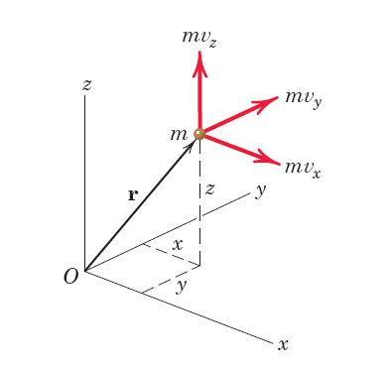
Angular Momentum
Linear Momentum

Slide 2
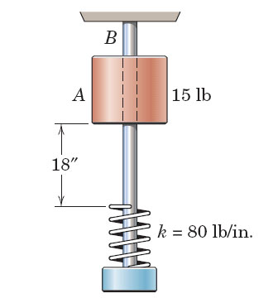
Always work from Principle!
Ex: Work of gravity
y
mg
Principle: dW = F * ds
Here: dW = - mg * dy

Slide 3
Always work from Principle!
Ex: Slider arm Kinematics
Principle: x-Position of A:
xA = b*cosθ(t)
a_{A}
v_{A}
The velocity x-dot is the derivative: x-dot = - b*ω *sinθ
Accel x-ddot is the 2nd derivative: x-ddot = - b*ω² *cosθ

Slide 4
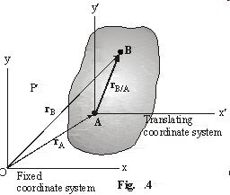
Chapter 16
Rigid Body Kinematics

Slide 5
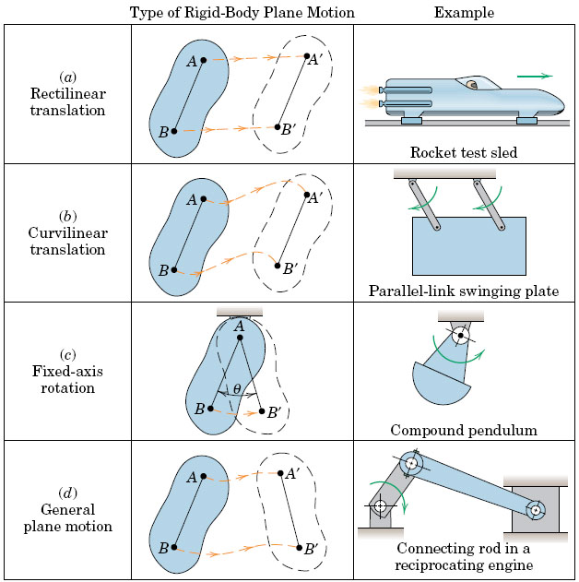
16.1
Notes:
5
5

Slide 6
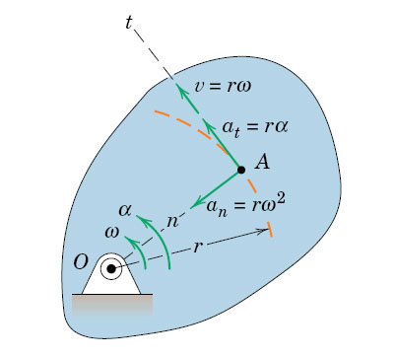
16.3 Rot. about Fixed Axis Memorize!
Notes:
6
6

Slide 7
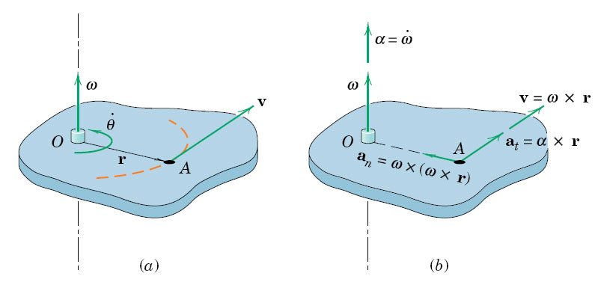
Vector Product is NOT commutative!
Notes:
7
7

Slide 8
Cross Product

Slide 9
Derivative of a Rotating Vector
vector r is rotating around the origin, maintaining a fixed distance
At any instant, it has an angular velocity of ω

Slide 10
Page 317:
a_{n} = ω x ( ω x r)
a_{t} = α x r

Slide 11
Rotation Kinematics
Similar to translation:
and

Slide 13
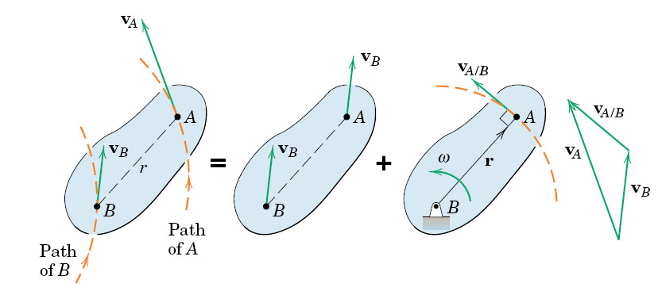
fig_05_006
Important!
Memorize and Practice!
General Motion = Translation + Rotation
Vector sum vA = vB + vA/B

Slide 14
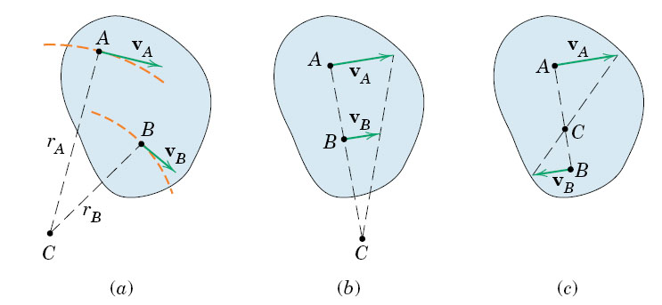
fig_05_007
Any rigid body motion can be viewed as a pure rotation about an “Instantaneous Center” (Chapter 16.6)

Slide 15
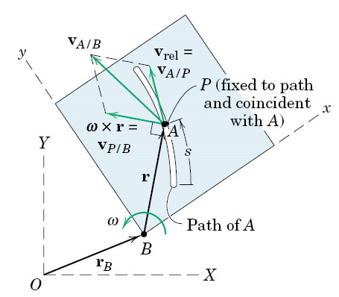
fig_05_011
fig_05_011

Slide 16
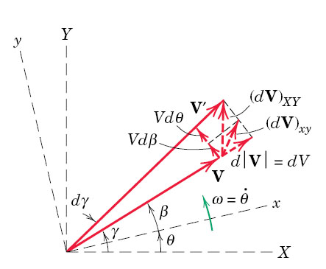
fig_05_012
fig_05_012

Slide 17
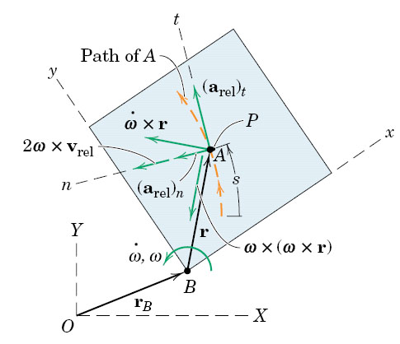
fig_05_013
fig_05_013

Slide 18
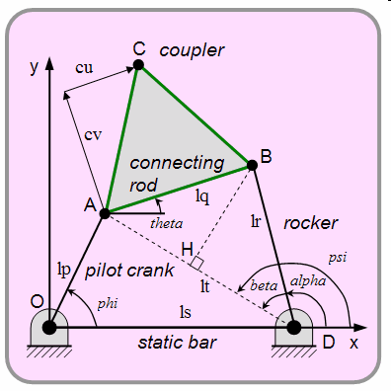
16.4 Motion Analysis

Slide 19
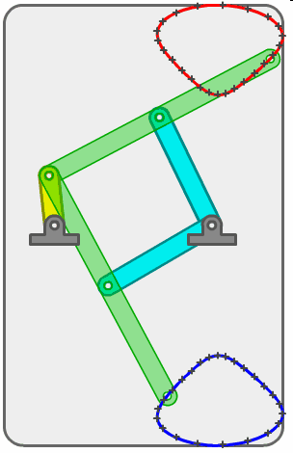
16.4 Motion Analysis
http://courses.engr.illinois.edu/tam212/aml.xhtml
http://www.mekanizmalar.com/fourbar01.html
http://iel.ucdavis.edu/chhtml/toolkit/mechanism/

Slide 20
1. A body subjected to general plane motion undergoes a/an
A) translation.
B) rotation.
C) simultaneous translation and rotation.
D) out-of-plane movement.
2. In general plane motion, if the rigid body is represented by a slab, the slab rotates
A) about an axis perpendicular to the plane.
B) about an axis parallel to the plane.
C) about an axis lying in the plane.
D) None of the above.
Notes:
20
Answers:
1. C
2. A

Slide 21
1. The position, s, is given as a function of angular position, θ, as s = 10 sin 2θ . The velocity, v, is
A) 20 cos 2θ B) 20 sin 2θ
C) 20 ω cos 2θ D) 20 ω sin 2θ
2. If s = 10 sin 2θ, the acceleration, a, is
A) 20 α sin 2θ B) 20 α cos 2θ − 40 ω² sin 2θ
C) 20 α cos 2θ D) -40 α sin2 θ
Notes:
21
Answers:
C
B

Slide 22
Approach
Geometry: Definitions
        Constants
        Variables
        Make a sketch
2a. Analysis (16.4) Derivatives (velocity and acceleration)
2b. Rel. Motion (16.5)
3. Equations of Motion
4. Solve the Set of Equations. Use Computer Tools.

Slide 23
Example
Bar BC rotates at constant ω_{BC}. Find the angular Veloc. of arm OA.
Step 1: Define the Geometry

Slide 24
Example
Bar BC rotates at constant ω_{BC}. Find the angular Veloc. of arm OA.
Step 1: Define the Geometry

Slide 25
16.5 Relative Motion Analysis
General Motion = Translation + Rotation
Vector sum vB = vA + vB/A

Slide 26
Geometry: Compute all lengths and angles as f(θ(t))
All angles and distance AC(t) are time-variant
Velocities: ω = θ-dot is given.

Slide 27
Analysis: Solve the rel. Veloc. Vector equation
Seen from O:
vA = ω_{ΟΑ} x OA

Slide 28
Analysis: Solve the rel. Veloc. Vector equation
v_{A},rel = v_{Coll}
Seen from C:
v_{Collar} + ω_{BC} x AC(t)
ω_{BC} x AC(t)

Slide 29
Analysis: Solve the rel. Veloc. Vector equation numerically

Slide 30
Analysis: Solve the rel. Veloc. Vector equation numerically
Here: ω_{BC} is given as -2 rad/s (clockwise). Find ω_{OA}

Slide 31
Analysis: Solve the rel. Veloc. Vector equation numerically

Slide 32
Recap: The analysis is becoming more complex.
To succeed: Try
Clear Organization from the start
Mathcad
Vector Equation = 2 simultaneous equations, solve simultaneously!

Slide 33
fig_05_011
Relative Velocity
v_{A} = v_{B} + v_{A/B}
v_{Rot} = ω x r
Relative Velocity
v_{A} = v_{B} + v_{A/B}
₌ V_{B (transl)}+ v_{Rot}
fig_05_011

Slide 34
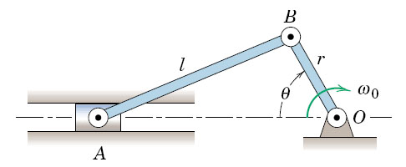
Seen from O:
v_{B} = ω_{ο} x r
Seen from A:
v_{B} = v_{A} + ω_{ΑΒ} x r_{B/A}

Slide 35
Seen from O:
v_{B} = ω_{ο} x r
Seen from A:
v_{B} = v_{A} + ω_{ΑΒ} x r_{B/A}

Slide 36
Visualization
http://courses.engr.illinois.edu/tam212/aml.xhtml
http://www.mekanizmalar.com/fourbar01.html
http://iel.ucdavis.edu/chhtml/toolkit/mechanism/

Slide 37
fig_05_012
Mathcad Examples
Crank and Slider Pin
part 1
Geometry

Slide 38
fig_05_012
Mathcad Examples
Crank and Pin
part 2:
Solving the vector equations

Slide 39
fig_05_012
Mathcad Examples
Crank and slider Pin
part 3
Graphical Solution

Slide 40
Given Velocity
V_A = const as shown at left
The velocity of Point B is
constant, same as V_A
constant, but different from V_A
V_{B}(t) is variable
(D) None of the above

Slide 47
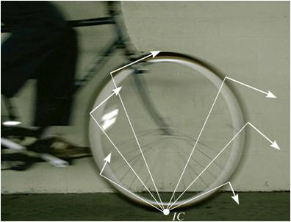
16.6 INSTANTANEOUS CENTER OF ZERO VELOCITY
Today’s Objectives:
Students will be able to:
Locate the instantaneous center of zero velocity.
Use the instantaneous center to determine the velocity of any point on a rigid body in general plane motion.
Notes:
47

Slide 48
Rigid Body Acceleration
Chapter 16.7
Stresses and Flow Patterns in a Steam Turbine
FEA Visualization (U of Stuttgart)

Slide 49
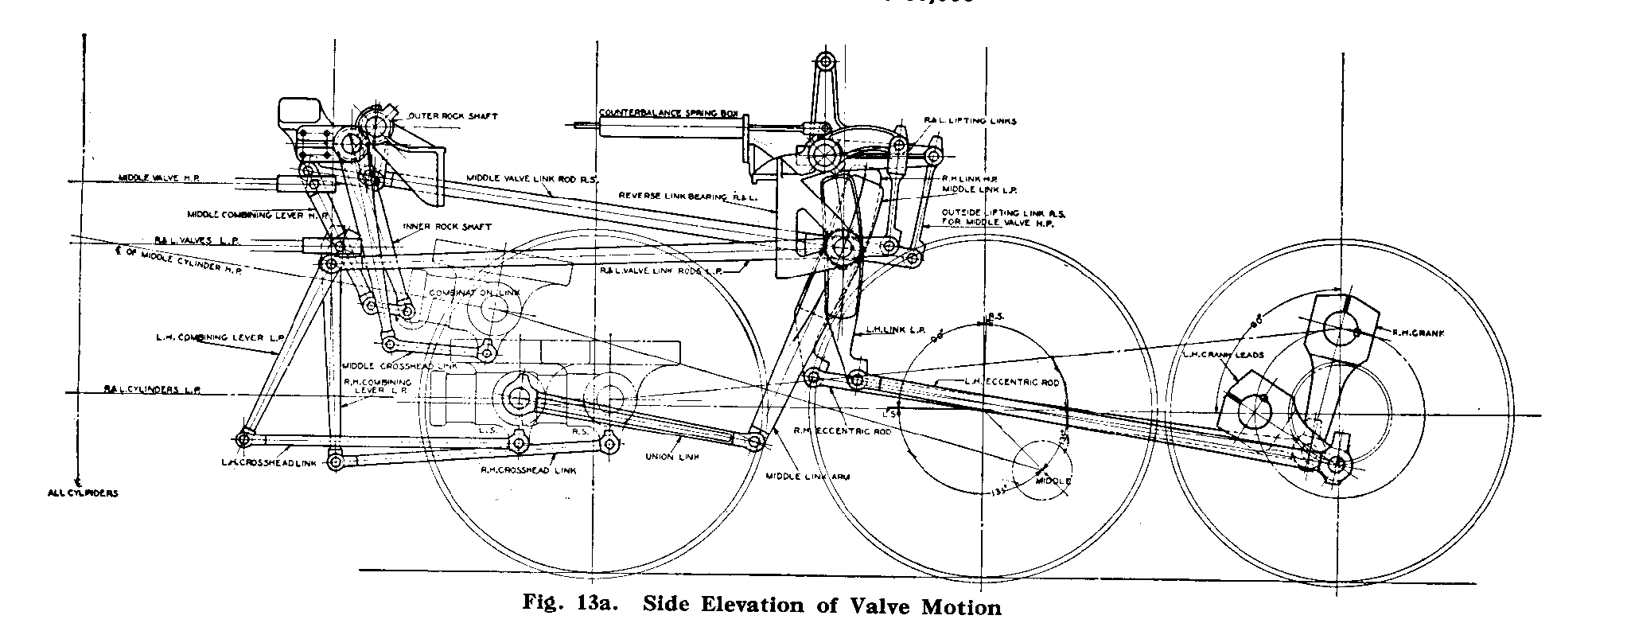
Rigid Body Acceleration
Conceptual Solution
Using Vector Graphics
Propulsion Mechanism of a Baldwin Steam Locomotive
Baldwin Locomotive Works, Philadelphia, 1926

Slide 50
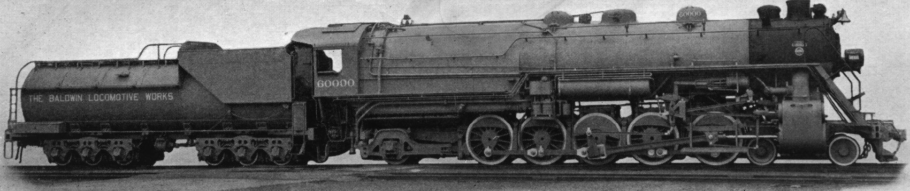
Baldwin Locomotive 60,000
Q: Is this a Freight or Passenger Locomotive ?
A: We can tell from the wheel diameter.

Slide 51
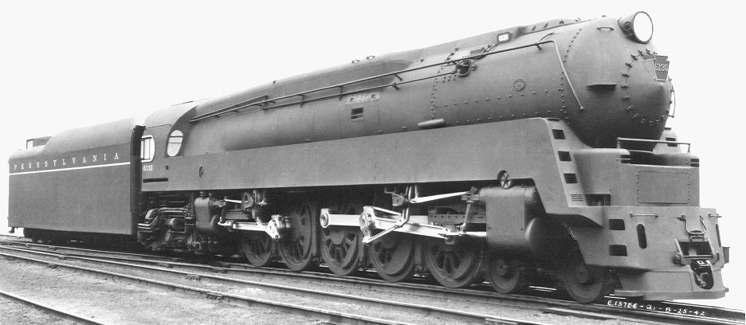
The internal forces (accelerations) in the piston mechanism limit the maximum speed (10 m/s max. Piston velocity).

Slide 52
Rigid Body Acceleration
First:
Find all velocities.

Slide 65
General Procedure
Compute all velocities and angular velocities.
Start with centripetal acceleration: It is ALWAYS oriented inward towards the center.

Slide 66
General procedure
Compute all velocities and angular velocities.
Start with centripetal acceleration: It is ALWAYS oriented inward towards the center.
3. The angular accel is NORMAL to the
Centripetal acceleration.

Slide 67
General Procedure
Compute all velocities and angular velocities.
Start with centripetal acceleration: It is ALWAYS oriented inward towards the center.
3. The angular accel is NORMAL to the
Centripetal acceleration. The direction of the angular acceleration is found from the mathematical analysis.

Slide 68
ω_{AB} = -11.55k
ω_{BC} = -5k
1. Find all v_{i} and ω_{i} (Ch. 16.5)
2. aB = α_{AB}Xr_{B} – ω_{AB}²*r_{B}
3. a_{B} = a_{C} + α_{BC}Xr_{B/C} – ω_{BC}²*r_{B/C}

Slide 69
Centripetal Terms: We know magnitudes and directions
We now can solve two simultaneous vector equations for α_{AB} and α_{BC}
– ω_{BC}²*r_{B/C}
– ω_{AB}²*r_{B}
a_{C}
α_{AB}Xr_{B} – ω_{AB}²*r_{B} = a_{C} + α_{BC}Xr_{B/C} – ω_{BC}²*r_{B/C}

Slide 70
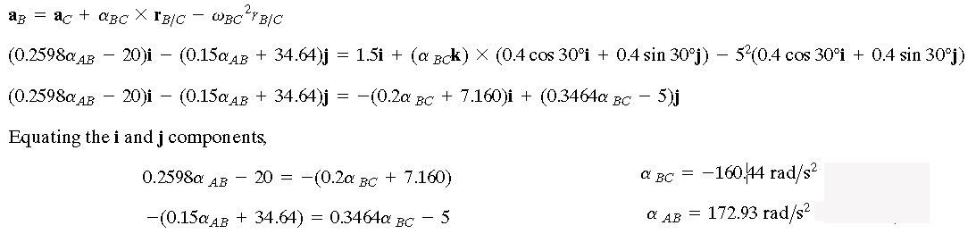
α_{AB}Xr_{B} – ω_{AB}²*r_{B} = a_{C} + α_{BC}Xr_{B/C} – ω_{BC}²*r_{B/C}

Slide 71
fig_05_011
16.8 Relative Motion
fig_05_11

Slide 72
fig_05_011
16.8 Relative Motion

Slide 73
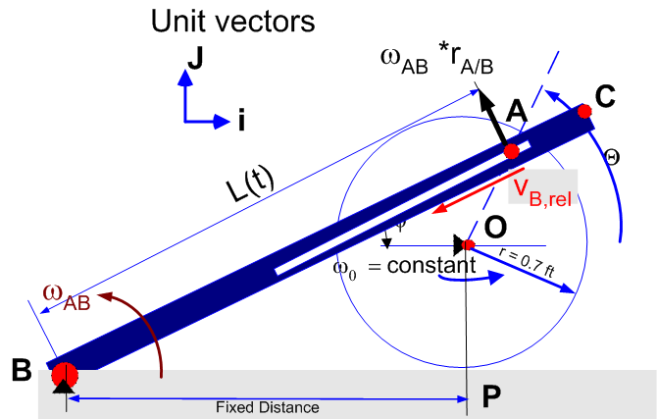
Seen from B:
v_{A} = v_{B,rel} +
ω_{ΑΒ} x r_{A/B}
Seen from P:
v_{A} = ω_{ο} x r
Velocities

Slide 74
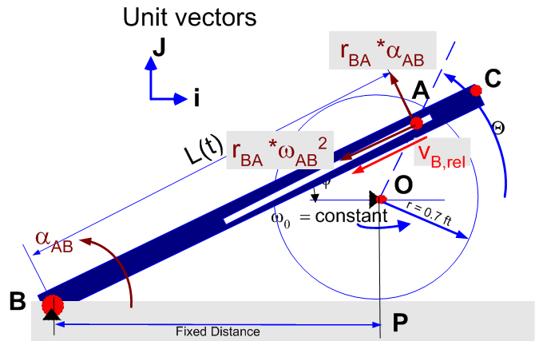
Seen from B:
a_{A} = a_{A,rel} + 2ωxv_{rel}
α_{ΑΒ} x r_{A/B}+centrip.
Seen from P:
a_{A} = α_{ο} x r+centr.
Accelerations

Slide 75
Midterm #2 Preparation
Posted:
Collection of Problems
Practice exam #2
Powerpoint Slides
Four questions will be on Chapter 16, 2Q. on Ch. 14
Stresses and Flow Patterns in a Steam Turbine
FEA Visualization (U of Stuttgart)

