Slide 1
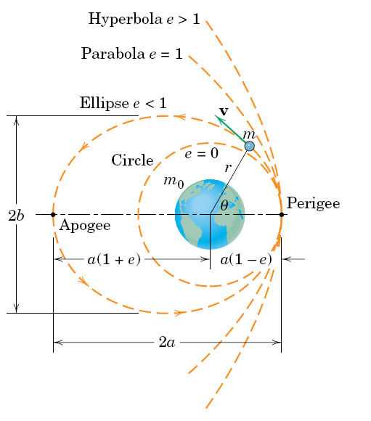
fig_03_022
13-7 Central Force Motion p. 155

Slide 2
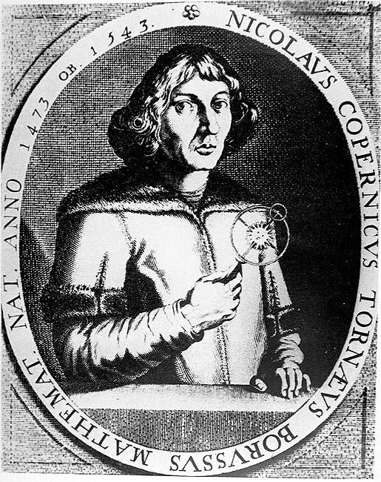
Nicolaus Copernicus

Slide 3
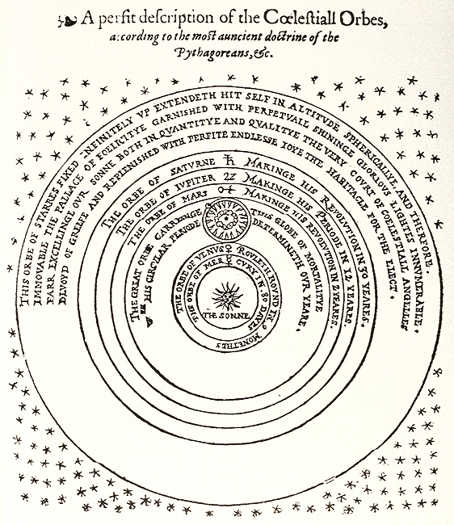
Copernicus’ Universe

Slide 4
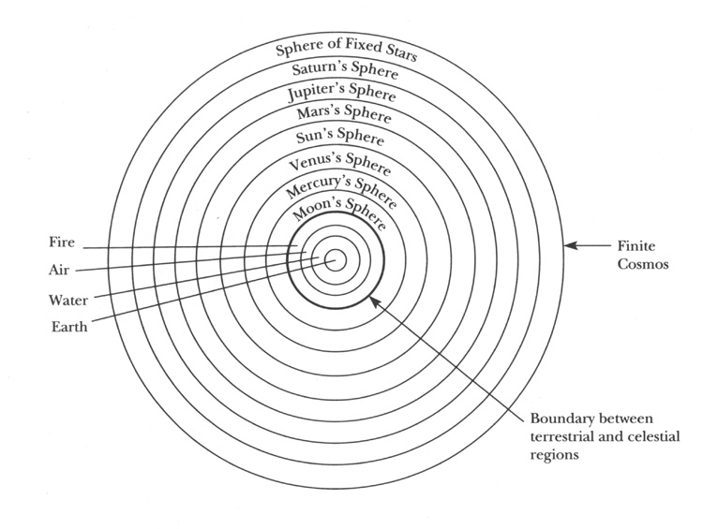
Contrast Copernicus with the Aristotelian Cosmos

Slide 5
GALILEO
Galileo Galilei 1564 - 1642
Galileo's most original contributions to science were in mechanics: he helped clarify concepts of acceleration,
velocity, and instantaneous motion.
astronomical discoveries, such as the moons of Jupiter.
planets revolve around the sun (The heliocentric model was first popularized by Nicholas Copernicus of Poland. )
Was forced to revoke his views by the church
Church recanted in 1979 - more that 300 years after Galileo’s death.

Slide 6
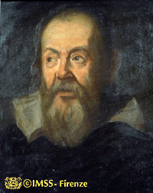
Galileo Galilei

Slide 7
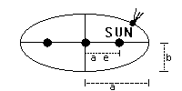

Kepler's Laws
See: http://www.cvc.org/science/kepler.htm
LAW 1: The orbit of a planet/comet about the Sun is an ellipse with the Sun's center of mass at one focus
This is the equation for an ellipse:

Slide 8
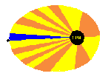
Kepler's Laws
LAW 2: A line joining a planet/comet and the Sun sweeps out equal areas in equal intervals of time

Slide 9
Isaac Newton (1642-1727)
Experiments on dispersion, nature of color, wave nature of light (Opticks, 1704)
Development of Calculus, 1665-1666
Built on Galileo and others' concepts of instantaneous motion.
Built on method of infinitesimals of Kepler (1616) and Cavalieri (1635). Priority conflict with Liebniz.
Gravitation 1665-1687
Built in part on Kepler's concept of Sun as center of solar system,
planets move faster near Sun.
Inverse-square law.
Once law known, can use calculus to drive Kepler's Laws.
Unification of Kepler's Laws; showed their common basis.
Priority conflict with Hooke.

Slide 10
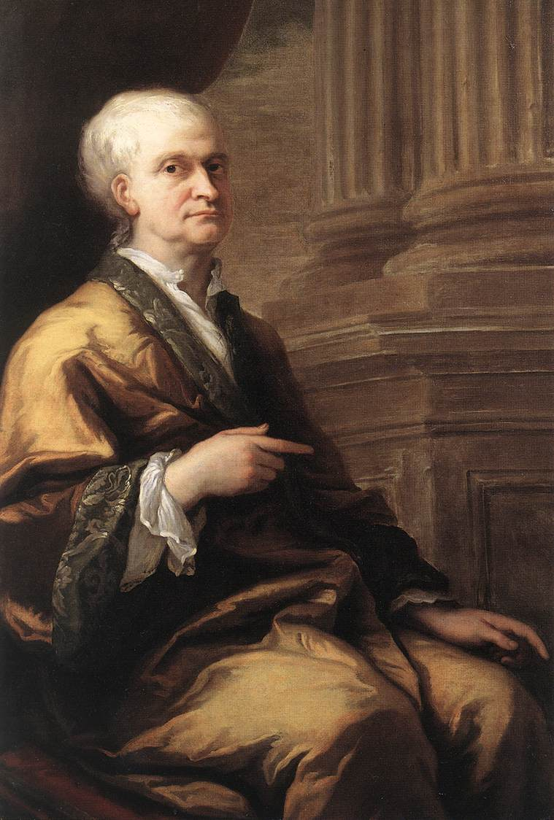
Isaac Newton
(1643-1727)
THORNHILL, Sir James Oil on canvas
Woolsthorpe Manor, Lincolnshire

Slide 11
Newton demonstrated that the motion of objects on the Earth could be described by three laws of motion, and then he went on to show that Kepler's three laws of Planetary Motion were but special cases of Newton's three laws if a force of a particular kind (what we now know to be the gravitational force) were postulated to exist between all objects in the Universe having mass. In fact, Newton went even further: he showed that Kepler's Laws of planetary motion were only approximately correct, and supplied the quantitative corrections that with careful observations proved to be valid.

Slide 12

Newton's Universal Law of Gravitation
Objects will attract one another by an amount that depends only on their respective masses and their distance, R

Slide 13
There’s always that incisive alternate viewpoint!
From: Richard Lederer “History revised”, May 1987

Slide 14
Chapter 14
Energy Methods

Slide 15
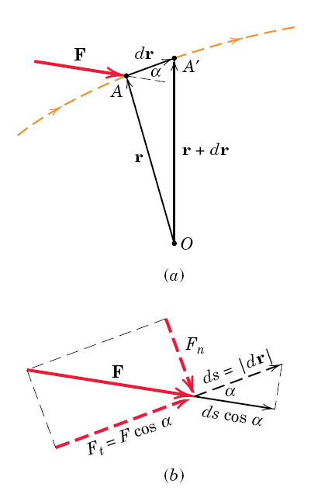
Work and Energy

Slide 16
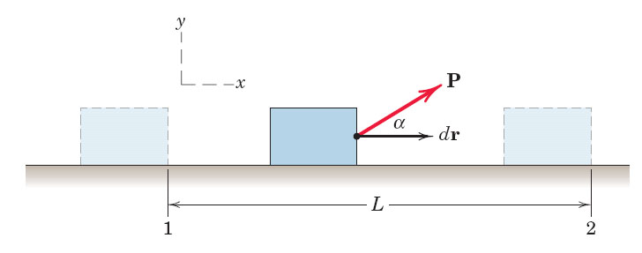
Only Force components in direction of motion do WORK

Slide 17
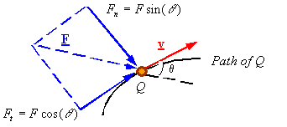
Work of a force: The work U₁₋₂ of a force on a particle over the interval of time from t₁ to t₂ is the integral of the scalar product over this time interval.

Slide 18
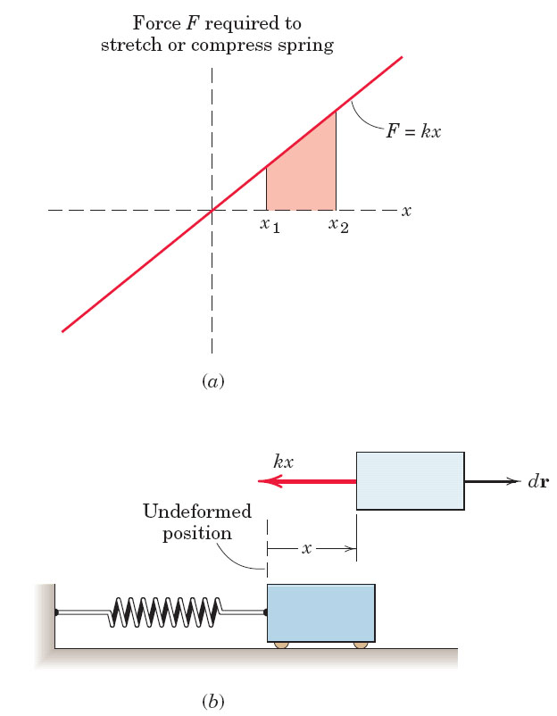
Work of a Spring
Note: Spring force is –k*x
Therefore:
dW = –k*x*dx

Slide 19
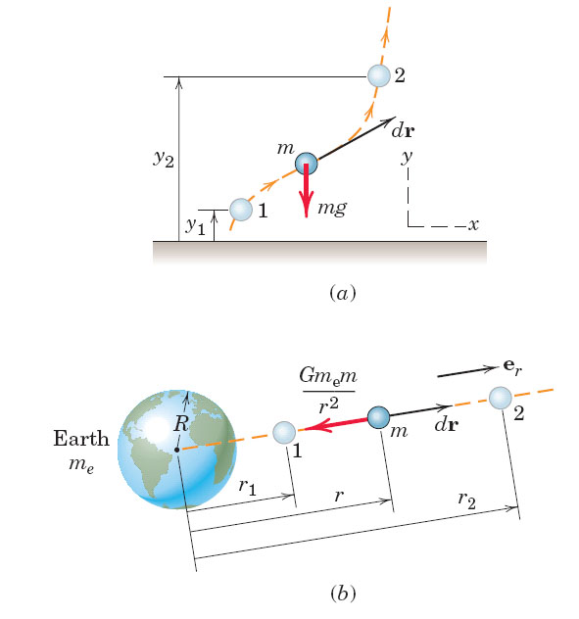
Work of Gravity

Slide 20

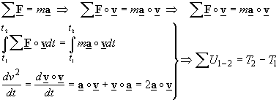
The work-energy relation: The relation between the work done on a particle by the forces which are applied on it and how its kinetic energy changes follows from Newton’s second law.

Slide 21

The work-energy relation: The relation between the work done on a particle by the forces which are applied on it and how its kinetic energy changes follows from Newton’s second law.

Slide 23
Q. “Will you grade on a curve?”
A.
Consider the purpose of your studies: a successful career
Not to learn is counterproductive
3. Help is available.

Slide 24

Q. “Should I invest in my own Future?”
A. Education pays

Slide 25
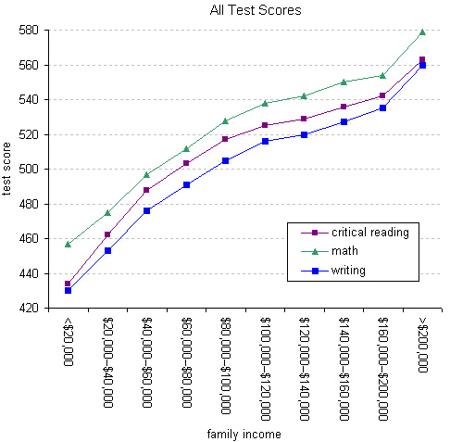
SAT Scores
Source:
economix.blogs.nytimes.com

Slide 26
Work/Energy Theorem

Slide 27
Power
Units of power:
J/sec = N-m/sec = Watts
1 hp = 746 W

Slide 28
Work done by Variable Force: (1D)
For variable force, we find the area
by integrating:
  dW = F(x) dx.
F(x)
x₁
x₂
dx

Slide 29
Conservative Forces
A conservative force is one for which the work done is independent of the path taken
Another way to state it:
The work depends only on the initial and final positions,
not on the route taken.

Slide 30
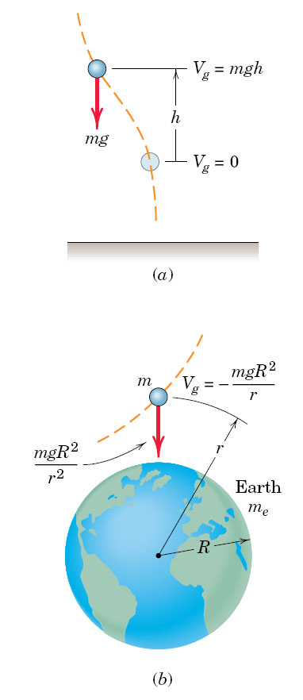
fig_03_008
Potential of Gravity
fig_03_008

Slide 31
The potential energy V is defined as:

Slide 32
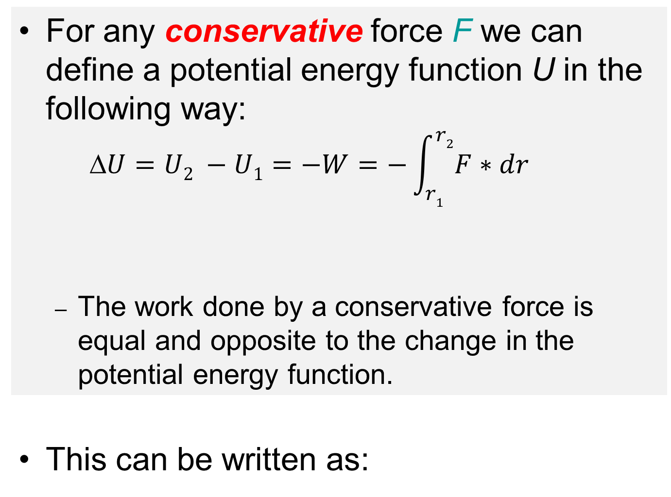
Potential Energy due to Gravity
For any conservative force F we can define a potential energy function U in the following way:
  $$U=U2 −U1=−W=−\int_{r1}^{r2}{F∗dr}$$
  The work done by a conservative force is equal and opposite to the change in the potential energy function.
This can be written as:
r₂
U₂
r₁
U₁

Slide 33
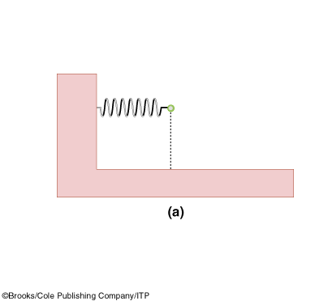
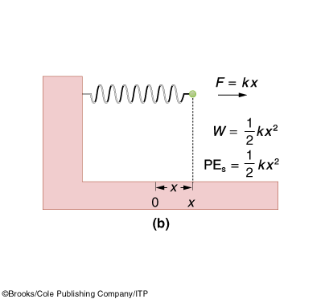
Hooke’s Law
Force exerted to compress a spring is proportional to the amount of compression.

Slide 34
Conservative Forces & Potential Energies
Force
F
Work
W(1 to 2)
Change in P.E
ΔU = U₂ - U₁
P.E. function
V
-mg(y₂-y₁)
mg(y₂-y₁)
mgy + C
(R is the center-to-center distance, x is the spring stretch)

Slide 35
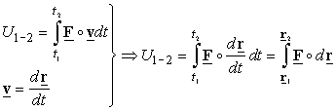


Other methods to find the work of a force are:

